Slide 1
Tax Foundation University
Session 1: The Individual Tax Code

Slide 2
Areas of Focus
The Basics of Individual Income Taxes
Family and Worker Tax Credits
The Basics of Passthrough Businesses
TCJA Individual Expirations and Options for Reform

Slide 3
Principles of Sound Tax Policy
Simplicity
Neutrality
Transparency
Stability
Tax codes should be easy for taxpayers to comply with and for governments to administer and enforce.
Taxes should neither encourage nor discourage personal or business decisions. The purpose of taxes is to raise needed revenue, not to favor or punish specific industries, activities, and products.
Tax policies should clearly and plainly define what taxpayers must pay and when they must pay it. Hiding tax burdens in complex structures should be avoided.
Taxpayers deserve consistency and predictability in the tax code. Governments should avoid enacting temporary tax laws, including tax holidays, amnesties, and retroactive changes, and strive to establish stable revenue sources.

Slide 4
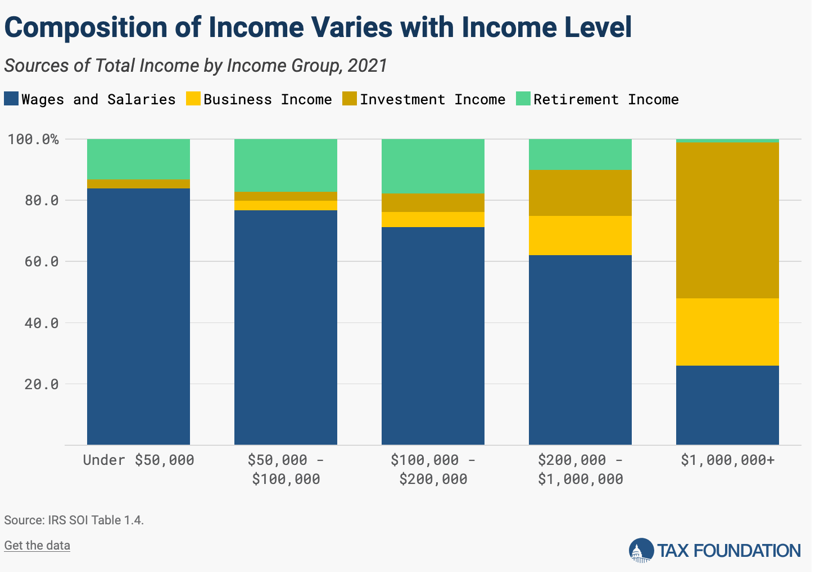
Sources of Personal Income
Employee wages and salaries make up the bulk of taxable income for Americans.
Investment and business income becomes more prominent as incomes rise.
Retirement income from pensions, private retirement savings and Social Security is another important income source.
Notes:
Taxable income is mostly wages and salaries derived from labor income, but other sources of income subject to tax include retirement income, income derived from investments (such as capital gains or interest income), and business profits for passthrough firms. Investment and business income make up a larger share of total income for higher earners.

Slide 5
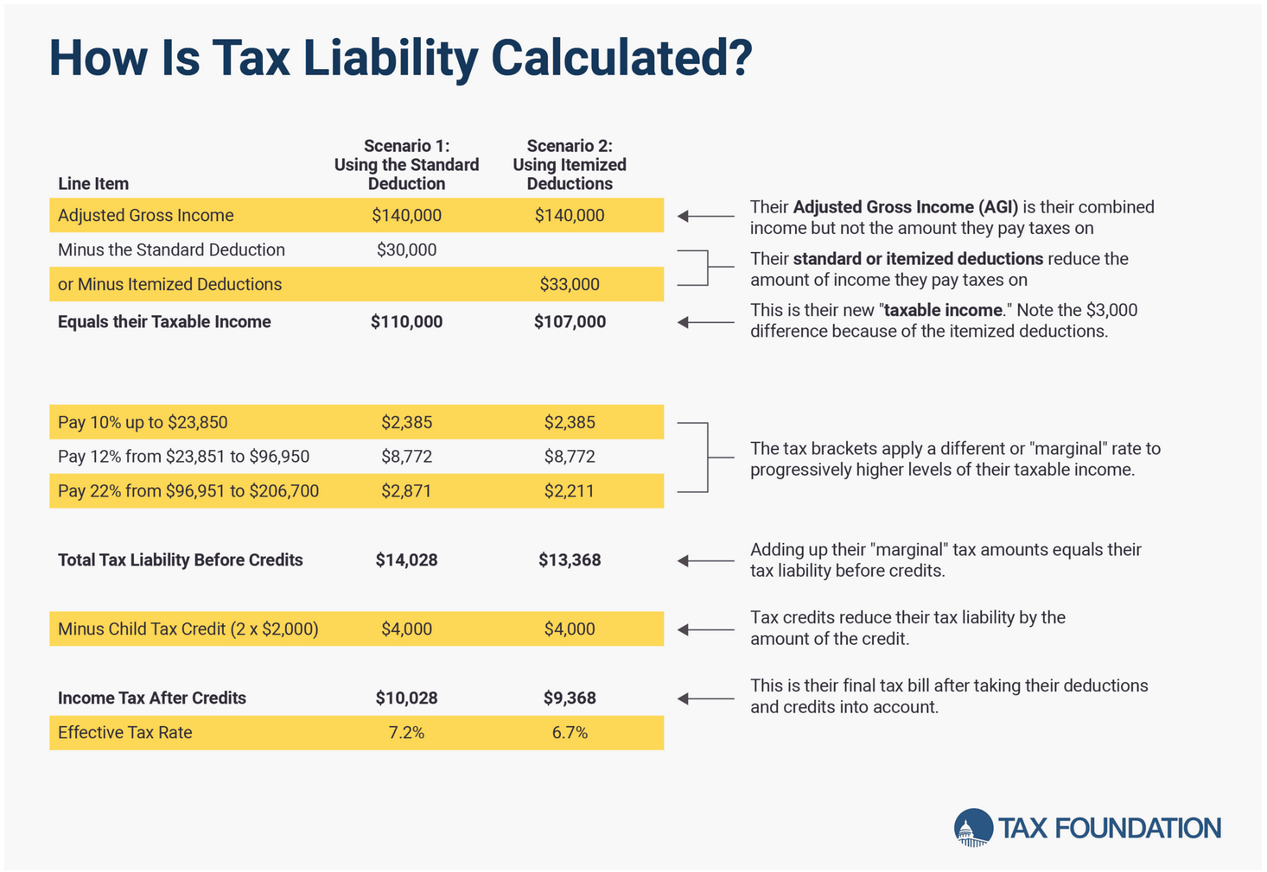
Individual Income Taxes, Step-by-Step
Taxpayers must determine their adjusted gross income (AGI)
Choice of standard deduction and itemizing deductions to arrive at taxable income
Tax Rate x Tax Base = Tax Liability
Tax credits can offset liability
  Child Tax Credit
  Earned Income Tax Credit
  Child and Dependent Care Tax Credit
Notes:
A critical component of the income tax are deductions, which reduce income subject to tax. The federal income tax provides a standard deduction worth $15,000 for single filers and $30,000 for joint filers in 2025. For most taxpayers, it only makes sense to itemize specific deductions such as state and local taxes, mortgage interest, and charitable contributions of the value of itemized deductions exceed the standard deduction. Since 2018, about 91 percent of taxpayers take the standard deduction.
The income tax is a major source of revenue collection for the U.S. federal government, collecting about $3 trillion out of $4.9 trillion in revenue in fiscal year 2024. There were about 153.5 million tax filers in tax year 2021.

Slide 6
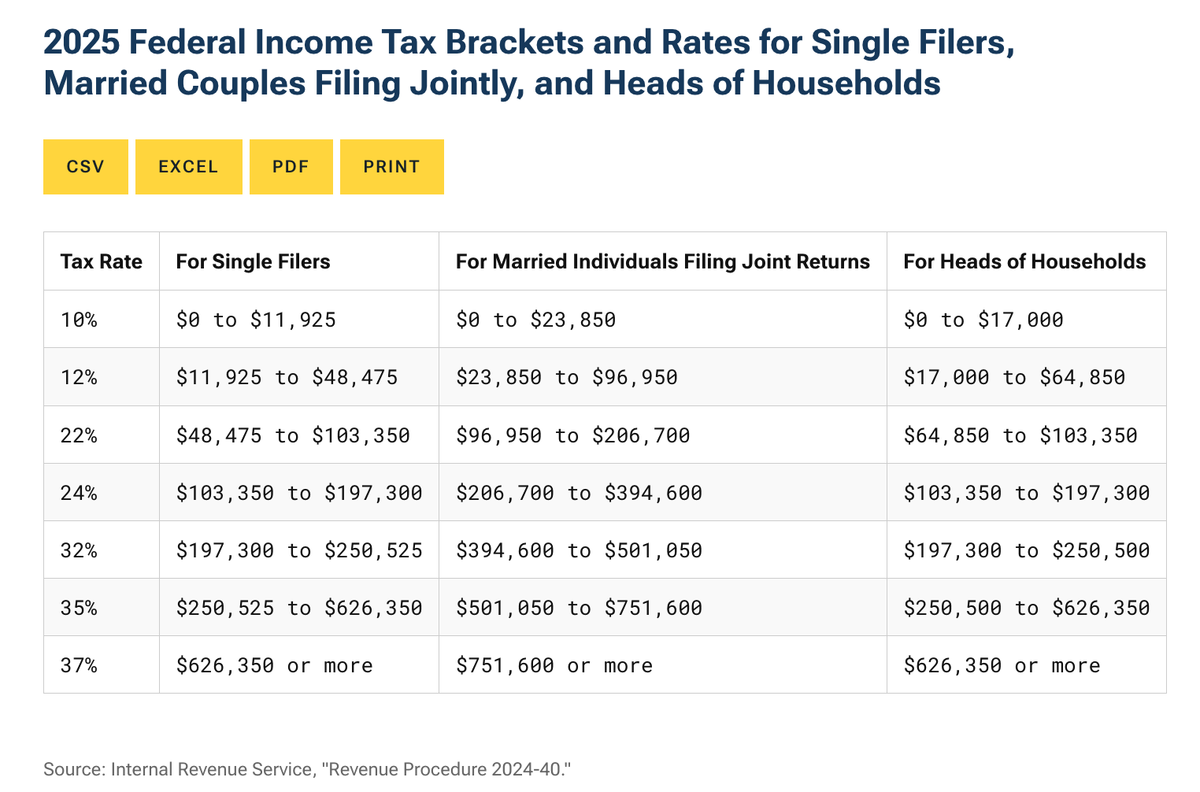
Individual Income Tax Schedule
Individual income taxes are progressive and levied on the margin
Rising marginal tax rates apply to taxable income above incremental income amounts.
Tax brackets are adjusted for joint filers but not fully compared to single filers.
Notes:
Taxable income is mostly wages and salaries derived from labor income, but other sources of income subject to tax include retirement income, income derived from investments (such as capital gains or interest income), and business profits for passthrough firms. Investment and business income make up a larger share of total income for higher earners.
The federal income tax is a graduated-rate structure, where every dollar of income above each threshold is taxed at a higher rate, results in marginal tax rates, the amount of additional tax paid for every additional dollar earned as income

Slide 7
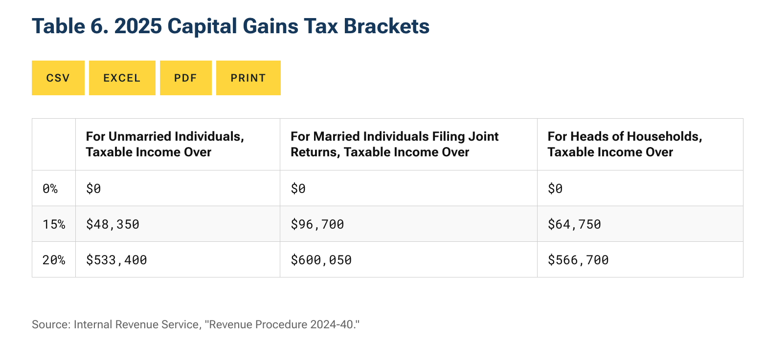
Capital Gains Income
Short-term capital gains and dividends are taxed at ordinary income tax rates.
Long-term capital gains (held for one year or longer) and qualified dividends are subject to a separate set of tax brackets.
Capital gains are taxed when realized.
Notes:
Because capital gains are only taxed when realized, taxpayers can choose when they pay, which makes capital income significantly more responsive to tax changes than other types of income.
Capital gains are taxed when realized, and long-term gains/qualified dividends are taxed at special rates (up to a top rate of 23.8 percent).
Higher capital gains taxes cause investors to sell their assets less frequently, which leads to less taxes being levied. This is known as the realization or lock-in effect.
Why are capital gains tax rates lower? This is to mitigate double taxation of corporate income, partially account for inflation over time, and encourage investment.
Additionally, taxpayers with income above $200,000 face a 3.8 percent Net Investment Income Tax on their investment income, meaning the top rate on capital gains reaches 23.8 percent.

Slide 8
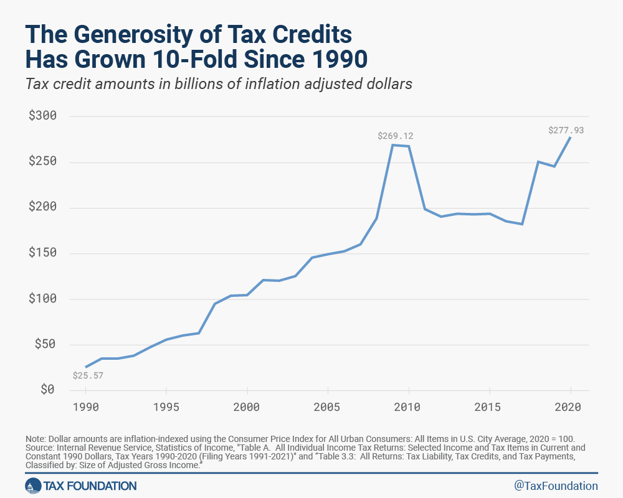
Tax Credits
Tax credit reduce a taxpayer’s final tax bill dollar-for-dollar.
Credits like the child tax credit and earned income tax credit aim to encourage work and support families.
Credits have become an increasing aspect of the tax code over the last 3 decades.
Notes:
A tax credit is a provision that reduces a taxpayer’s final tax bill, dollar-for-dollar. A tax credit differs from deductions and exemptions, which reduce taxable income, rather than the taxpayer’s tax bill directly.
Tax credits can be divided into two types: Refundable and nonrefundable. A refundable tax credit allows a taxpayer to receive a refund if the credit they are owed is greater than their tax liability. A nonrefundable credit allows a taxpayer to only receive a reduction in their tax liability until it reaches zero.

Slide 9
Worker and Family Tax Credits
 | ARPA Policy, 2021 | TCJA Policy, 2022–2025 | Post-TCJA Policy, after 2025
Maximum Credit | $3,600 for children under age 6; $3,000 for children age 6 to 17 | $2,000 for children under age 17 | $1,000 for children under age 17
Amount Refundable | Fully refundable regardless of income | Partially refundable up to $1,600, indexed to inflation until it reaches $2,000 | Full amount refundable depending on earned income
Phase-in and phase-out | No phase-in Expanded $1,600 or $1,000 phases out by $50 for each $1,000 of income above $112,500 for head of household filers and $150,000 for joint filers, then follows TCJA | Refundable amount calculated by multiplying earned income above $2,500 by 15% Phases out by $50 for each $1,000 of AGI above $200,000 for single filers and $400,000 for married filing jointly | Refundable amount calculated by multiplying earned income above $3,000 by 15% Phases out by $50 for each $1,000 of AGI above $75,000 for single filers and $110,000 for joint filers
Notes:
About 48 million tax filers, or tax returns, typically claim the CTC. We know that due to the changes made in the American Rescue Plan, families of millions more children will claim the CTC for tax year 2021. CRS estimates that before last year’s expansion, 84% of families with children received the child tax credit, while for 2021, 96% of families with children will receive the credit.
The 2021 tax credit was expanded in several major ways under the American Rescue Plan. The maximum credit was increased from $2,000 to $3,600 for children under six and to $3,000 for children up to age 17, and that’s an expansion from the old max of 16. It was also made fully refundable, meaning instead of phasing in with income, the credit is fully available to lower-income households and households without earnings. And, it was partially paid out in advance monthly payments. The extra amount added to the credit phases out for higher income households. And another change is the age limit on the credit was increased from 16 years of age to 17.
All the changes to expand the credit amount and eligibility only applied to 2021, so beginning this year for 2022, the credit has reverted to its old structure of $2,000 max, with a phase in and a limit on the refundable portion of $1,500, which was set by the Tax Cuts and Jobs Act of 2017. After 2025, the TCJA changes will expire, and the credit will revert to a much smaller amount available to a much smaller share of households.
The credit is very complicated for some families filing their taxes and for the IRS to administer. The Government Accountability Office puts it this way, each child must meet certain age, residency and relationship tests. However, given complicated family relationships, determining whether children meet these eligibility requirements is not always clearcut, nor easily understood by taxpayers. This is especially true when filers share responsibility for the child with parents, former spouses, and other relatives or caretakers.
Taxpayers have to meet relationship, residency, and identification tests legally required to qualify for the CTC. Generally, only one adult or married couple can claim a tax credit for a child who is related to them, so first we have to meet a relationship test, then the child must live with them for more than half a year, so a residency test, and then must meet further conditions, such as age limits, which vary across the credits. Essentially, the IRS is tasked with administering a law that doesn’t always match up with family living situations, and that makes it difficult for everyone involved. The same issues play out for other refundable tax credit that depend on family status, such as the earned income tax credit.
In addition to administrative costs and revenue costs, tax credits affect incentives to work. Over the last year, for example, the work incentives of the Child Tax Credit were hotly debated.
The ways in which changing the CTC could impact decisions about work are often conflated. Clearing up the differences between income effects and substitution effects can help shed light on why analyses indicate a loss of jobs among recipients if the expanded CTC continues.
One way a policy change can affect labor supply decisions is through an income effect. The idea is that if people have more money overall, they might choose to work less and enjoy more leisure time. The literature, however, indicates that income effects are usually pretty small and might even be zero.
The other way a policy change can affect labor supply decisions is through a substitution effect. The idea is that if people see decreased compensation for an additional hour of work, for instance, through higher marginal tax rates, work becomes less valuable than leisure and they might choose to work less. Substitution effects hold up in the literature, and the research indicates they are greater than income effects.
Until the changes made in 2021, the CTC included a “participation bonus” for working, as eligibility depended on having earned income, and the credit phased in with earned income, reducing marginal tax rates for people along the phase-in range. But the new structure eliminates the participation bonus and increases marginal tax rates on low-income households along the phase-in range (see the blue line compared to the gold line in the accompanying chart). Therefore, we should expect to see a substitution effect in response to the higher marginal tax rates and elimination of the participation bonus.
Relatedly, in a review of the literature, the CBO finds “evidence that low-income workers have higher elasticities of labor supply than other workers, especially in the component of their labor response that reflects movement in and out of the workforce.”
There’s also an important question of the time frame for labor supply to respond to such changes. Typically, a three-year period is expected, but in some cases it can take people up to 8 years to fully learn and respond to a change in marginal tax rates. So, we generally should not expect to see a significant labor supply response right now to the ARPA CTC, since the policy was brand new, complicated, and temporary–and further, many families were completely unaware of the policy change.

Slide 10
Earned Income Tax Credit (2025 values)
Filing Status |  | No Children | 1 Child | 2 Children | 3+ Children
Single or Head of Household | Income at Max Credit | $8,490 | $12,730 | $17,880 | $17,880
 | Maximum Credit | $649 | $4,328 | $7,152 | $8,046
 | Phaseout Begins | $10,620 | $23,350 | $23,350 | $23,350
 | Phaseout Ends (Credit Equals Zero) | $19,104 | $50,434 | $57,310 | $61,555
Married Filing Jointly | Income at Max Credit | $8,490 | $12,730 | $17,880 | $17,880
 | Maximum Credit | $649 | $4,328 | $7,152 | $8,046
 | Phaseout Begins | $17,730 | $30,470 | $30,470 | $30,470
 | Phaseout Ends (Credit Equals Zero) | $26,214 | $57,554 | $64,430 | $68,675
Notes:
In the 2019 filing season, about 25 million workers and families received about $62 billion in EITC. The average amount of EITC received nationwide was about $2,461.
The Earned Income Tax Credit (EITC) is a refundable tax credit targeted at low-income working families. The value of the EITC is a fixed percentage of a household’s earned income until the credit reaches its maximum. The EITC stays at its maximum value as a household’s earned income continues to increase, until earnings reach a phaseout threshold, above which the credit drops by a fixed percentage for each additional dollar of income over the phaseout threshold. The EITC for workers without qualifying children is much, much lower than the credit available to workers without children. For 2021 only, the so-called childless EITC was nearly tripled, but it has now reverted to its smaller size.
to qualify for the EITC, taxpayers must meet at least 20 requirements, which tend to be very complicated. They address complicated family relationships and residency arrangements to determine eligibility, and the IRS lacks third party data to verify compliance with the rules. The EITC also contains significant marriage penalties, reducing or entirely eliminating benefits when a head of household filer marries a childless single filer. For example, the married filing jointly thresholds are not twice the size of the other thresholds but are instead only roughly $6,000 higher. Even though it is a highly complex credit, The EITC contains strong work incentives demonstrated to increase employment, especially among low-income mothers, and it lifts about 5 million children out of poverty each year.
But, the complicated nature of the credit leads to relatively high rates of payments made in error, the IRS estimates between 21 percent and 26 percent of EITC claims are paid in error, many of which are the result of unintentional errors due to complexity and some due to fraud. Most of the overpayments of the EITC are related to qualifying child errors. The complexity and error rates of the EITC are one reason why many reforms call for removing the family-status differential from the EITC and focusing it solely on work.

Slide 11
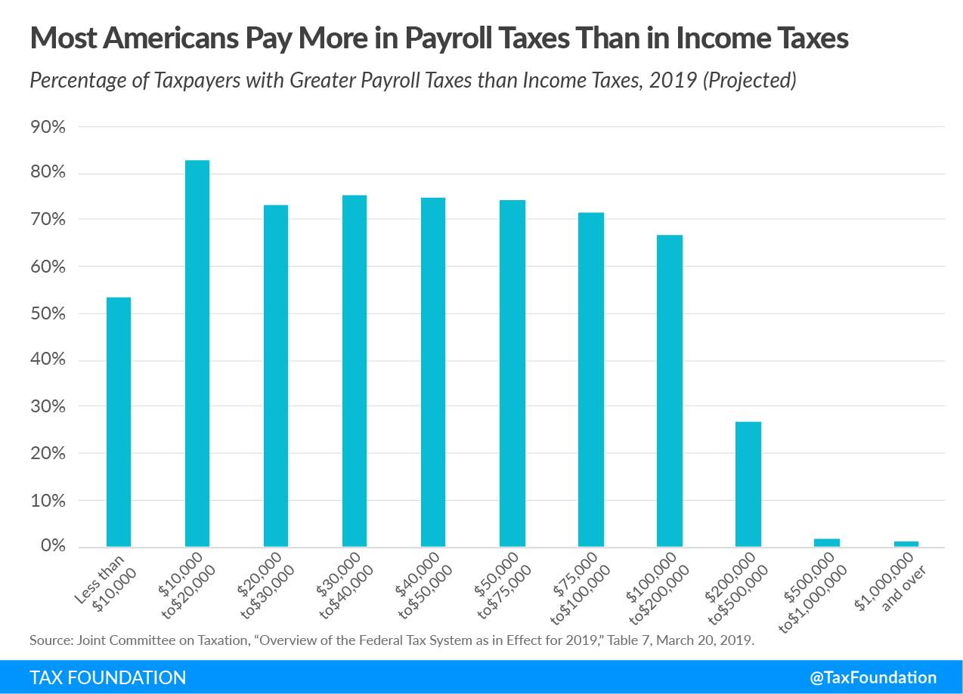
Payroll Taxes
In addition to individual income tax, households remit payroll tax on employee wages and self-employment.
Social Security payroll tax is split between employers and employees at 6.2% each and is capped at $176,100 in compensation.
Medicare tax of 2.9% is split between employers and employees applies to all wages and self-employment.

Slide 12
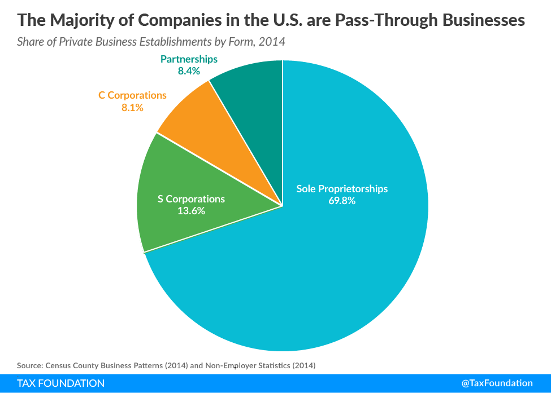
Noncorporate Income Taxes
Pass-through entities pass profits (or losses) directly to individual owners, single layer of tax
Taxed at personal tax rates
Owners take deductions, like Sec. 199A and Sec. 179
Vast majority of US companies are pass-through businesses.
Notes:
Business income in the United States is taxed under two different systems. C corporation income is taxed first at the entity level by the 21 percent corporate income tax and then again at the shareholder level by the individual income tax when profits are distributed (e.g., the top long-term capital gains tax rate is 23.8 percent). Pass-through businesses—including partnerships, sole proprietorships, and corporations electing to be taxed at the shareholder level (e.g., Subchapter S corporations, regulated investment companies [RICs], and real estate investment trusts [REITs]) do not face the corporate tax. Their business income is passed through to their owners and taxed on their individual income tax returns at rates of up to 37 percent.
Since the early 1980s, the pass-through sector has grown substantially as a share of all business activity. The pass-through share of business returns increased from 83.4 percent in 1980 to 96.2 percent in 2016 (see the first figure below). The number of C corporations decreased from around 2.2 million in 1980 to 1.6 million in 2016. During the same period, the total number of business entities tripled to 39 million. Pass-through businesses accounted for two-thirds of all net income (less deficit) in 2016, substantially increasing from 25.4 percent in 1980. The sharp growth in the pass-through sector since the 1980s was due in part to a significant improvement in their relative tax treatment. Tax reforms in 1981 and 1986 cut the top individual income tax rate from 70 percent in 1980 to 28 percent in 1988, while the top corporate income tax rate came down from 46 percent to 34 percent.
The most recent data from the IRS suggests that the trend toward more pass-through businesses and fewer C corporations has not broken.

Slide 13
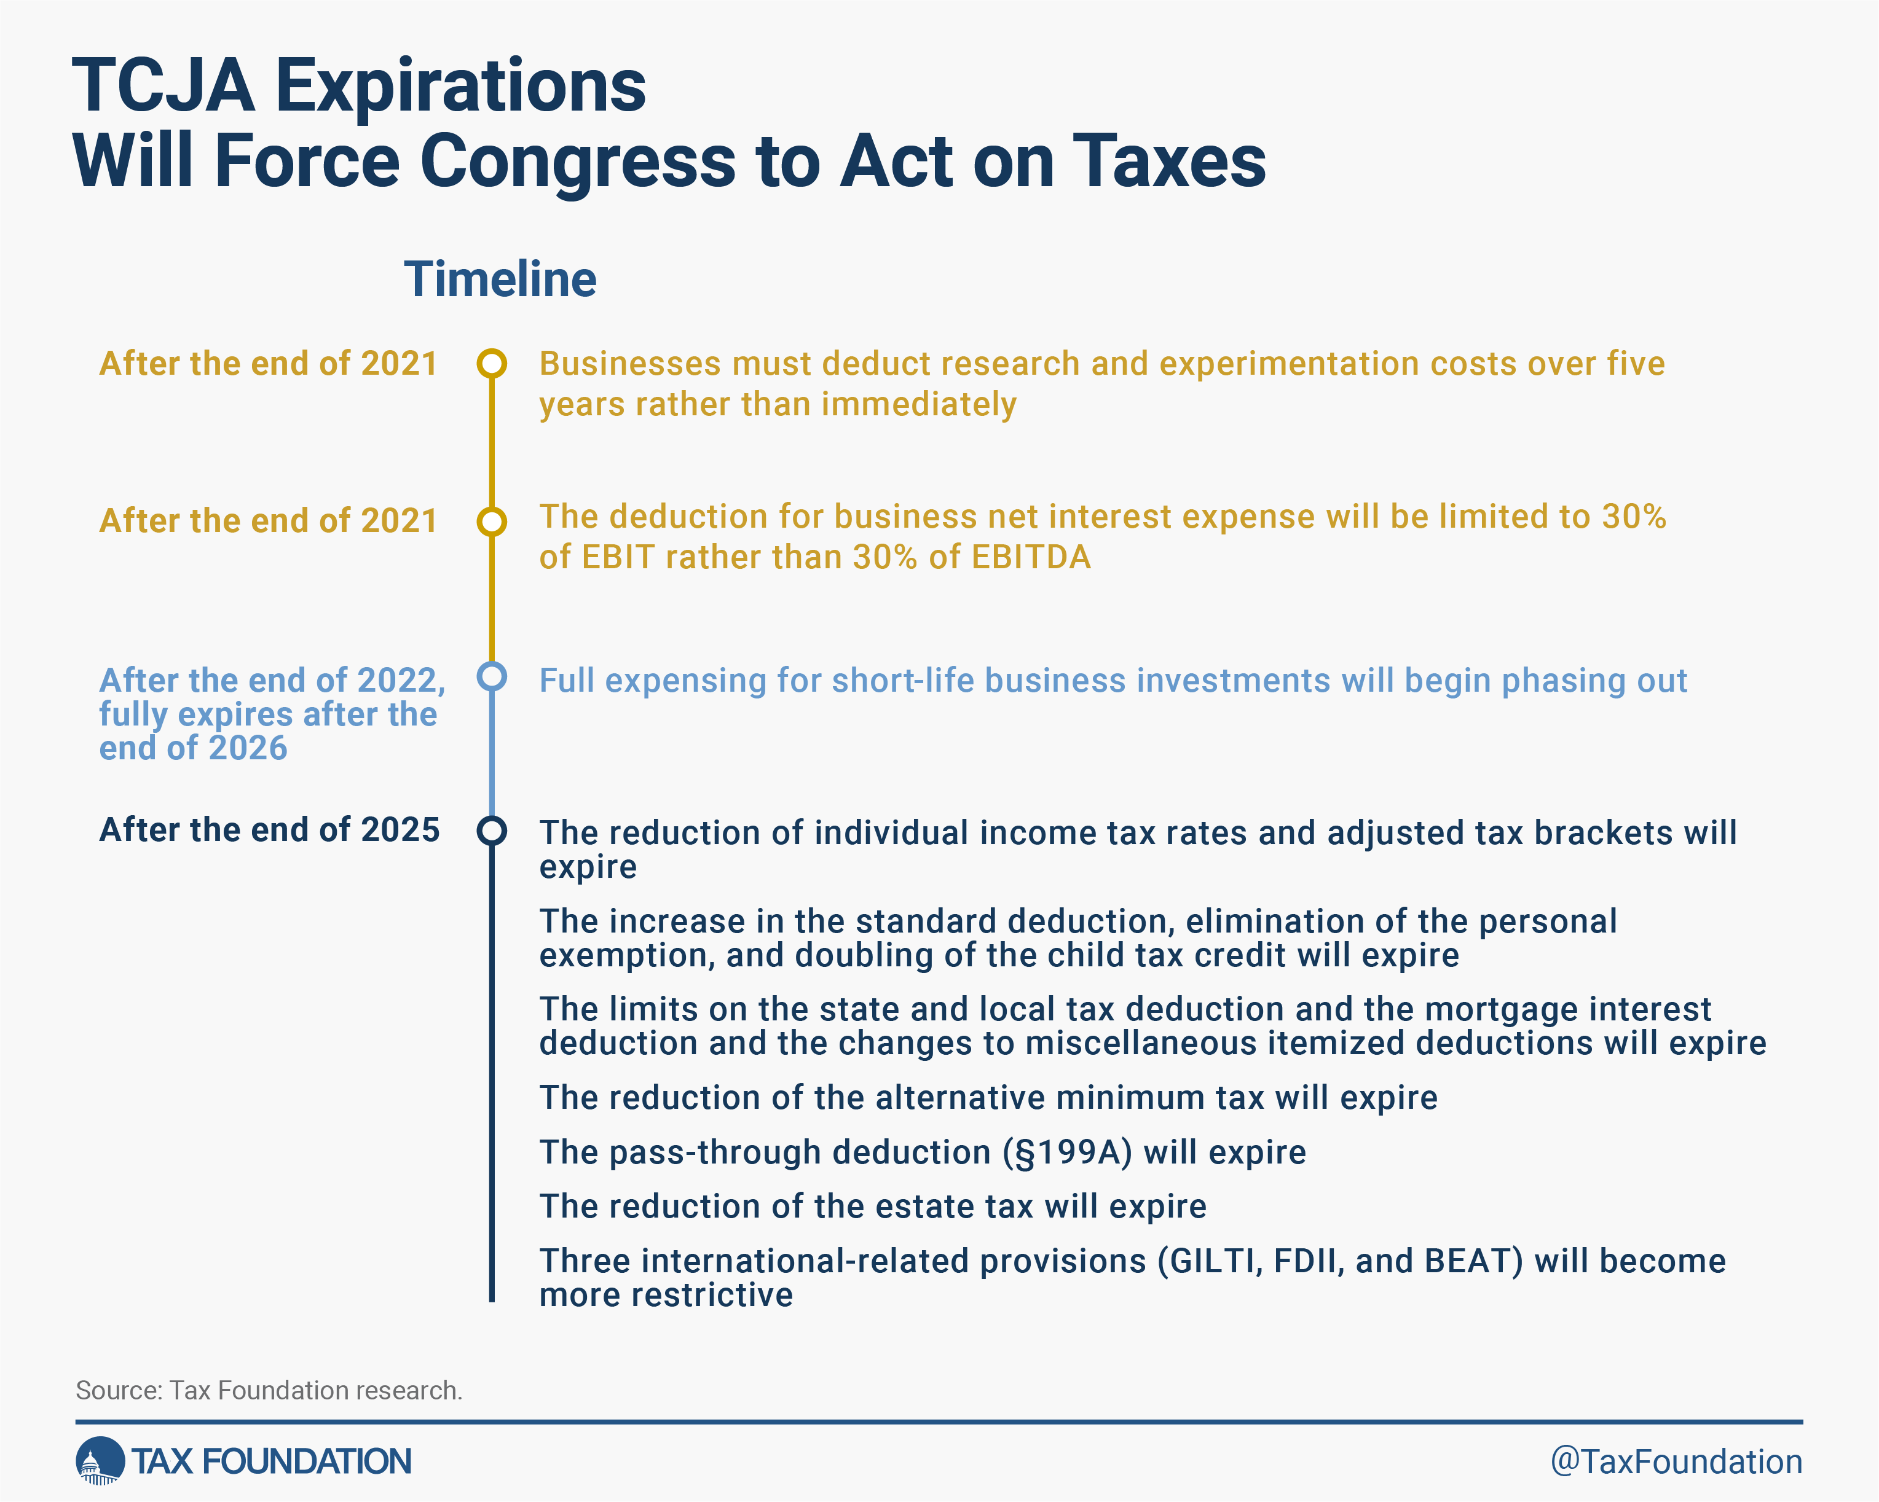
TCJA Background
Enacted in December 2017, ideas date back to at least the early 2010s.
Temporarily changed most aspect of the individual tax code.
TCJA cut taxes for most taxpayers.

Slide 14
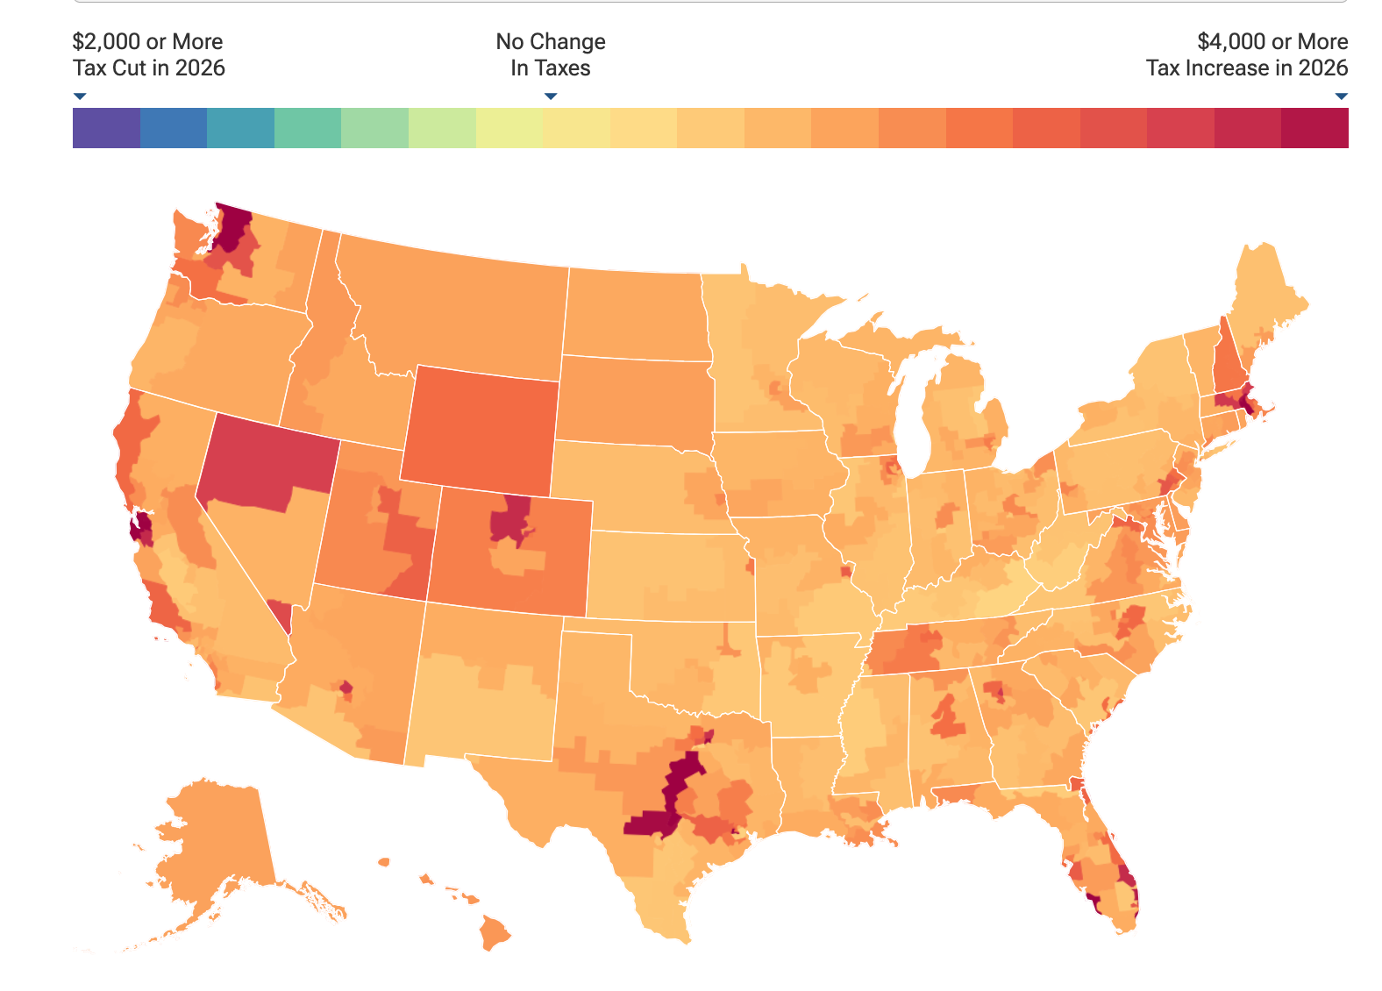
Tax Cuts and Jobs Act Individual Expirations
Individual tax provisions from the 2017 tax law expire at the end of 2025.
The average tax increase costs each taxpayers about $2,955 compared to current policy.
62 percent of taxpayers would see a tax increase if the provisions expire.

Slide 15
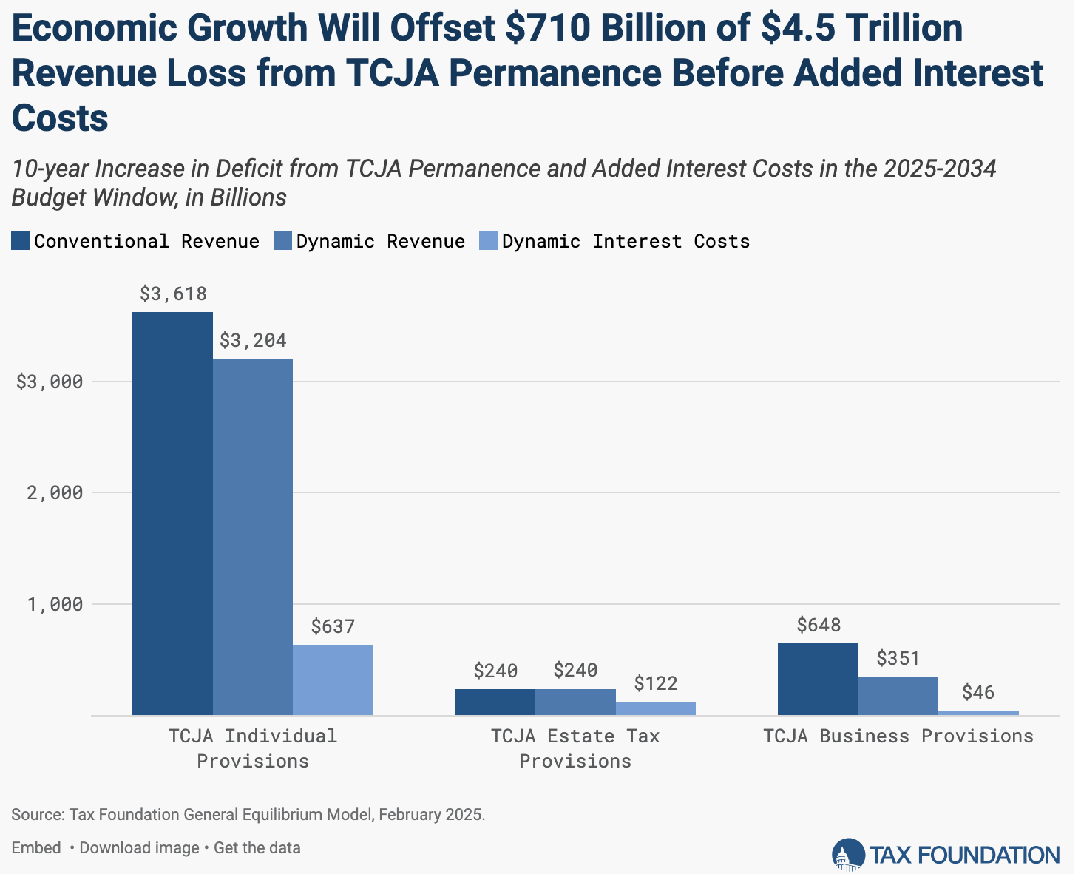
TCJA Extension Revenue Effects
The individual TCJA provisions are the biggest cost for extension. Reducing revenue by $3.6 trillion over ten years.
Tax Foundation finds economic growth offsets about $400 billion of the individual provision’s cost.

Slide 16
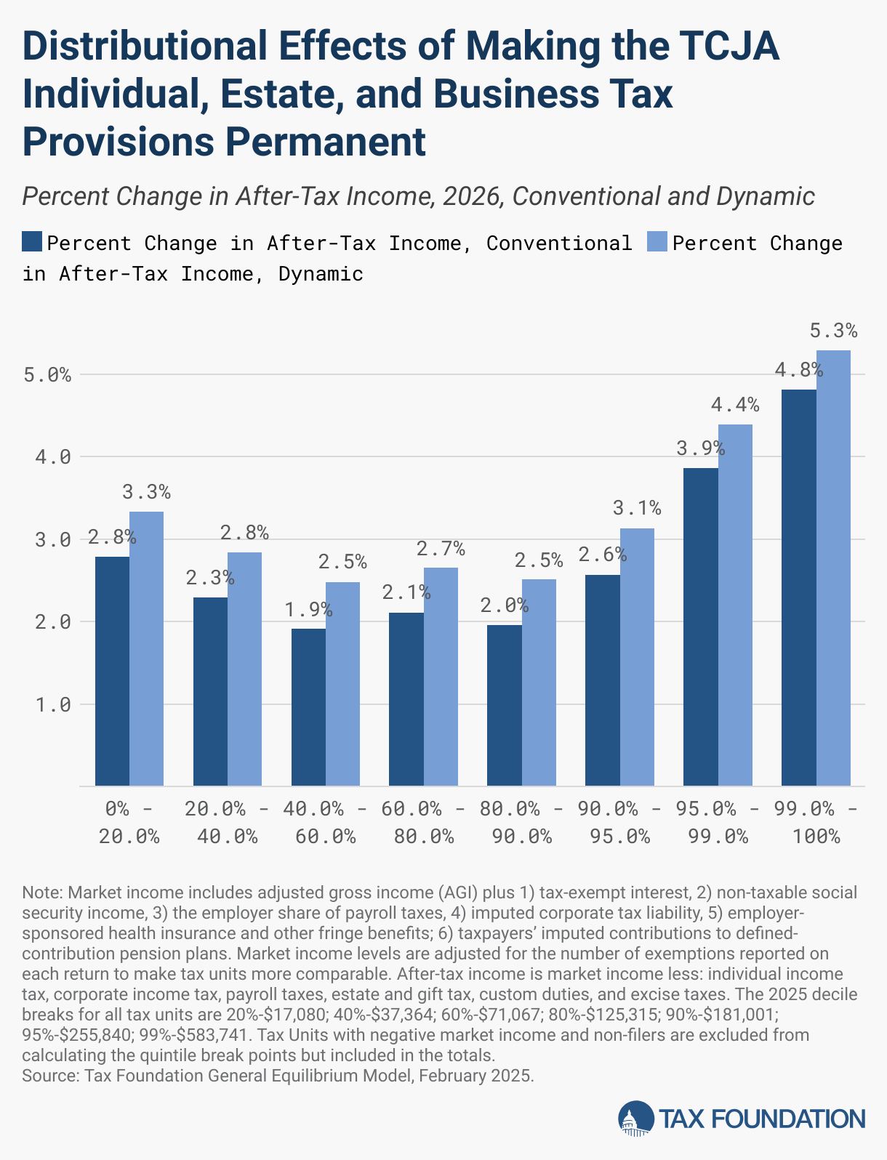
TCJA Extension Distributional Effects
Extending the individual provisions would increase average after-tax incomes by 1.9%
Taxpayers across the income distribution would benefit, ranging from 1.6% for the bottom 20% of earners to 2.0% for the top 20%.
Extending business and estate tax changes increase after-tax incomes further.

Slide 17
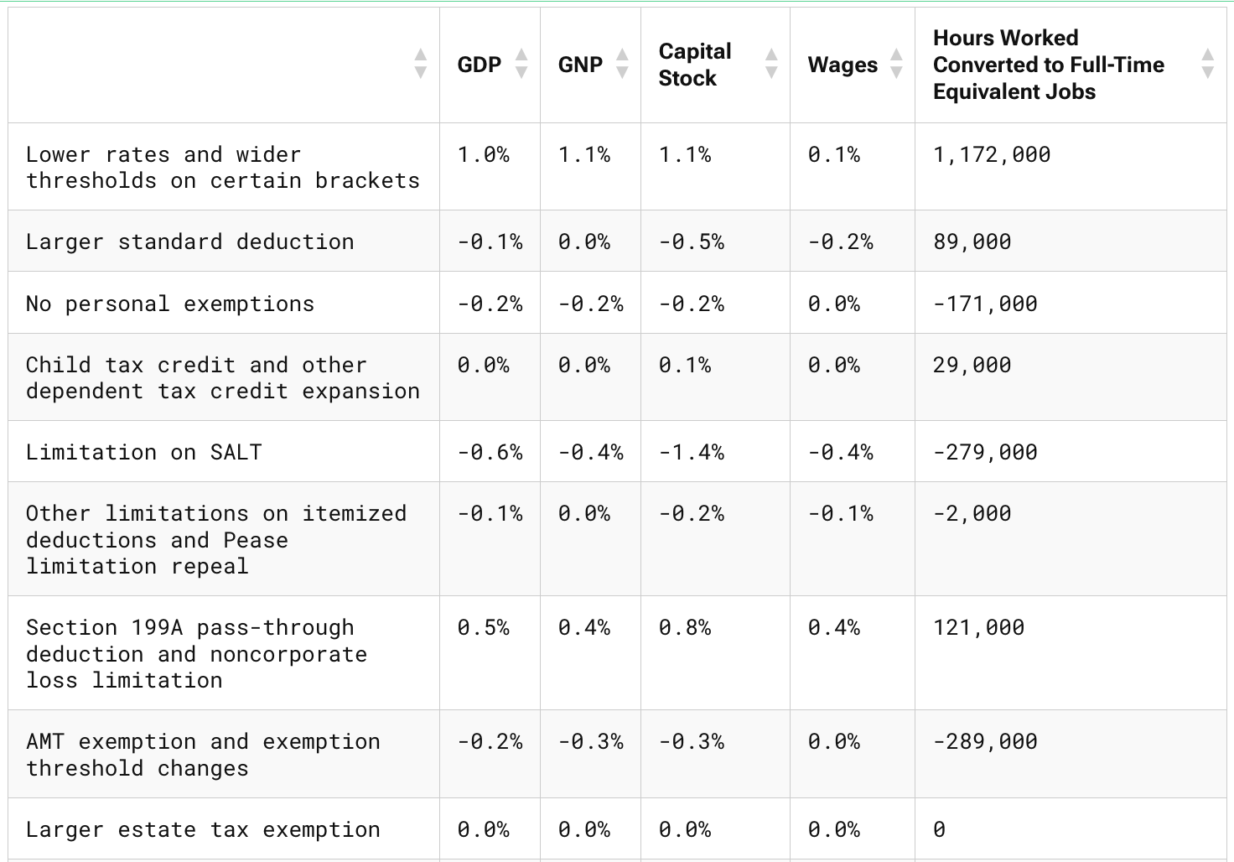
TCJA Individual Extension Economic Effects
Lower rates and wider brackets have the largest GDP effect.
The $10,000 SALT deduction cap has the biggest negative economic effect.
Items like the standard deduction expansion have smaller impacts but simplify the tax system.

Slide 18
TCJA Expirations and Options for Reform
The Expirations
Other Potential Proposals
Lower rates and brackets
Larger standard deduction
Expanded Child Tax Credit
Limitations on SALT, mortgage interest, other itemized deductions
Alternative minimum tax exemptions and thresholds
Suspended personal exemption
Other business provisions (tomorrow)
Change head of household provisions
Further limitations or repeal of SALT, HMID and other itemized deductions
Eliminate the AMT
Inflation adjustments for the child tax credit
Universal savings accounts
Reforms to 199A

Slide 19
Wrapping Up
Rate The individual income tax is a marginal tax rate structure, where every dollar of income above each threshold is taxed at a higher rate
Base The individual income tax base includes wages, interest and dividends, business income and capital gains. However, the federal income tax base is made narrower by various deductions and credits
Family and Worker Tax Credits The individual income tax provides substantial payments to workers and families with children through the earned income and child tax credits
2025 Expirations Making permanent the TCJA individual tax cuts would be pro-growth and keep tax burdens from rising but comes at a revenue cost. Base broadeners and pro-growth reforms should be considered

Slide 20
Questions?
Garrett Watson
gwatson@taxfoundation.org
@GS_Watson

