Slide 1
Tax Foundation University 2025
Course 3: March 19, 2025

Slide 2
Why Does International Tax Policy Matter?
Jobs
Multinational companies employ lots of people and pay more
Investment
MNEs account for a majority of R&D
Revenue:
More $ when companies want to be US companies
More $ when companies want to locate their income in the US

Slide 3
Goals of this Session
Apportionment: how do countries divvy up income?
Profit shifting: how do firms try to minimize taxes?
Goals of multinational systems: what are we optimizing?
TCJA (2017): What did our last reform look like?
OECD Global Minimum Tax Agreement: How does it affect us?
Next Congress: What are the options?

Slide 4
Review of Business Tax Concepts
C-Corporations: A legal entity that pays tax twice, at the entity level and when profits are distributed to shareholders. Most MNEs are structured as c-corporations.
Net Income: A business’ revenue minus expenses (cost of goods sold, payroll, etc.). The base for the corporate tax.
Corporate Income Tax: Tax that c-corporations pay on their net income subject to the 21 percent rate.
Deduction: Expenses that reduce taxable income.
Foreign Tax Credit: A credit for foreign corporate taxes paid for businesses subject to US tax. Reduces tax (almost) dollar for dollar.

Slide 5
Apportionment
How do we divvy up corporate income when multiple jurisdictions are involved?
Source-based: where the economic activity was produced.
Residence-based: where the corporation is headquartered.
Destination-based: where the activity was consumed.
How does the world today work?
Source-based is the most common system and tends to take precedence over the others.
Some countries, including the U.S., levy some additional residence-based taxes over the top on “their” companies.
Destination-based is situational. Countries might incorporate some destination-based principles to guard against profit shifting.

Slide 6
Profit Shifting
Make a deductible payment from a high-tax jurisdiction to a low-tax jurisdiction.
Often easiest when “intangibles” (roughly, abstract factors of production like brands or patents) are involved.
Exploits source-based tax systems.
Countries compete on policies other than headline tax rate.
Tactics also exist to exploit other tax systems.
Residence-based taxes are subject to inversions: use M&A to change residence to get out of residence-based taxes.
Destination-based taxes miss “quasi-exports” like hotels, struggle with e-commerce.

Slide 7
Goals of Multinational Tax Systems
Protect the domestic tax base.
Be an attractive place for global investment.
Make your home-grown firms competitive abroad.
Reduce complexity.

Slide 8
Tax Cuts and Jobs Act (2017):
Prior to TCJA, a 35 percent “worldwide” (residence-based) corporate income tax with unlimited deferral.
Two problems:
Companies would “defer” as long as possible, leading to arguments over “money held overseas.”
Those companies that could not defer would invert to avoid the residence-based taxes.
TCJA approach: reverse this entirely. Lower taxes on international income, but assess them immediately.

Slide 9
TCJA’s Carrot and Stick Approach
The Stick: Global intangible low-taxed income (GILTI)
10-13.1% rate. No deferral. Rises to 13.1% to 16.4% in 2026.
Break for substantive operations, known as qualified basic asset investment.
Foreign tax credits
The Carrot: Foreign-derived intangible income (FDII)
Partner to GILTI with similar attributes in terms of base and rate.
Applies to revenue derived from overseas but sourced to the U.S. for tax purposes.
Effectively, a low-rate “reward” for locating easily shiftable income in the U.S.
Base erosion and anti-abuse tax (BEAT)
Limits “base erosion payments” as a share of deductions.
Effectively, statistical discrimination against a suspicious tax profile.

Slide 10
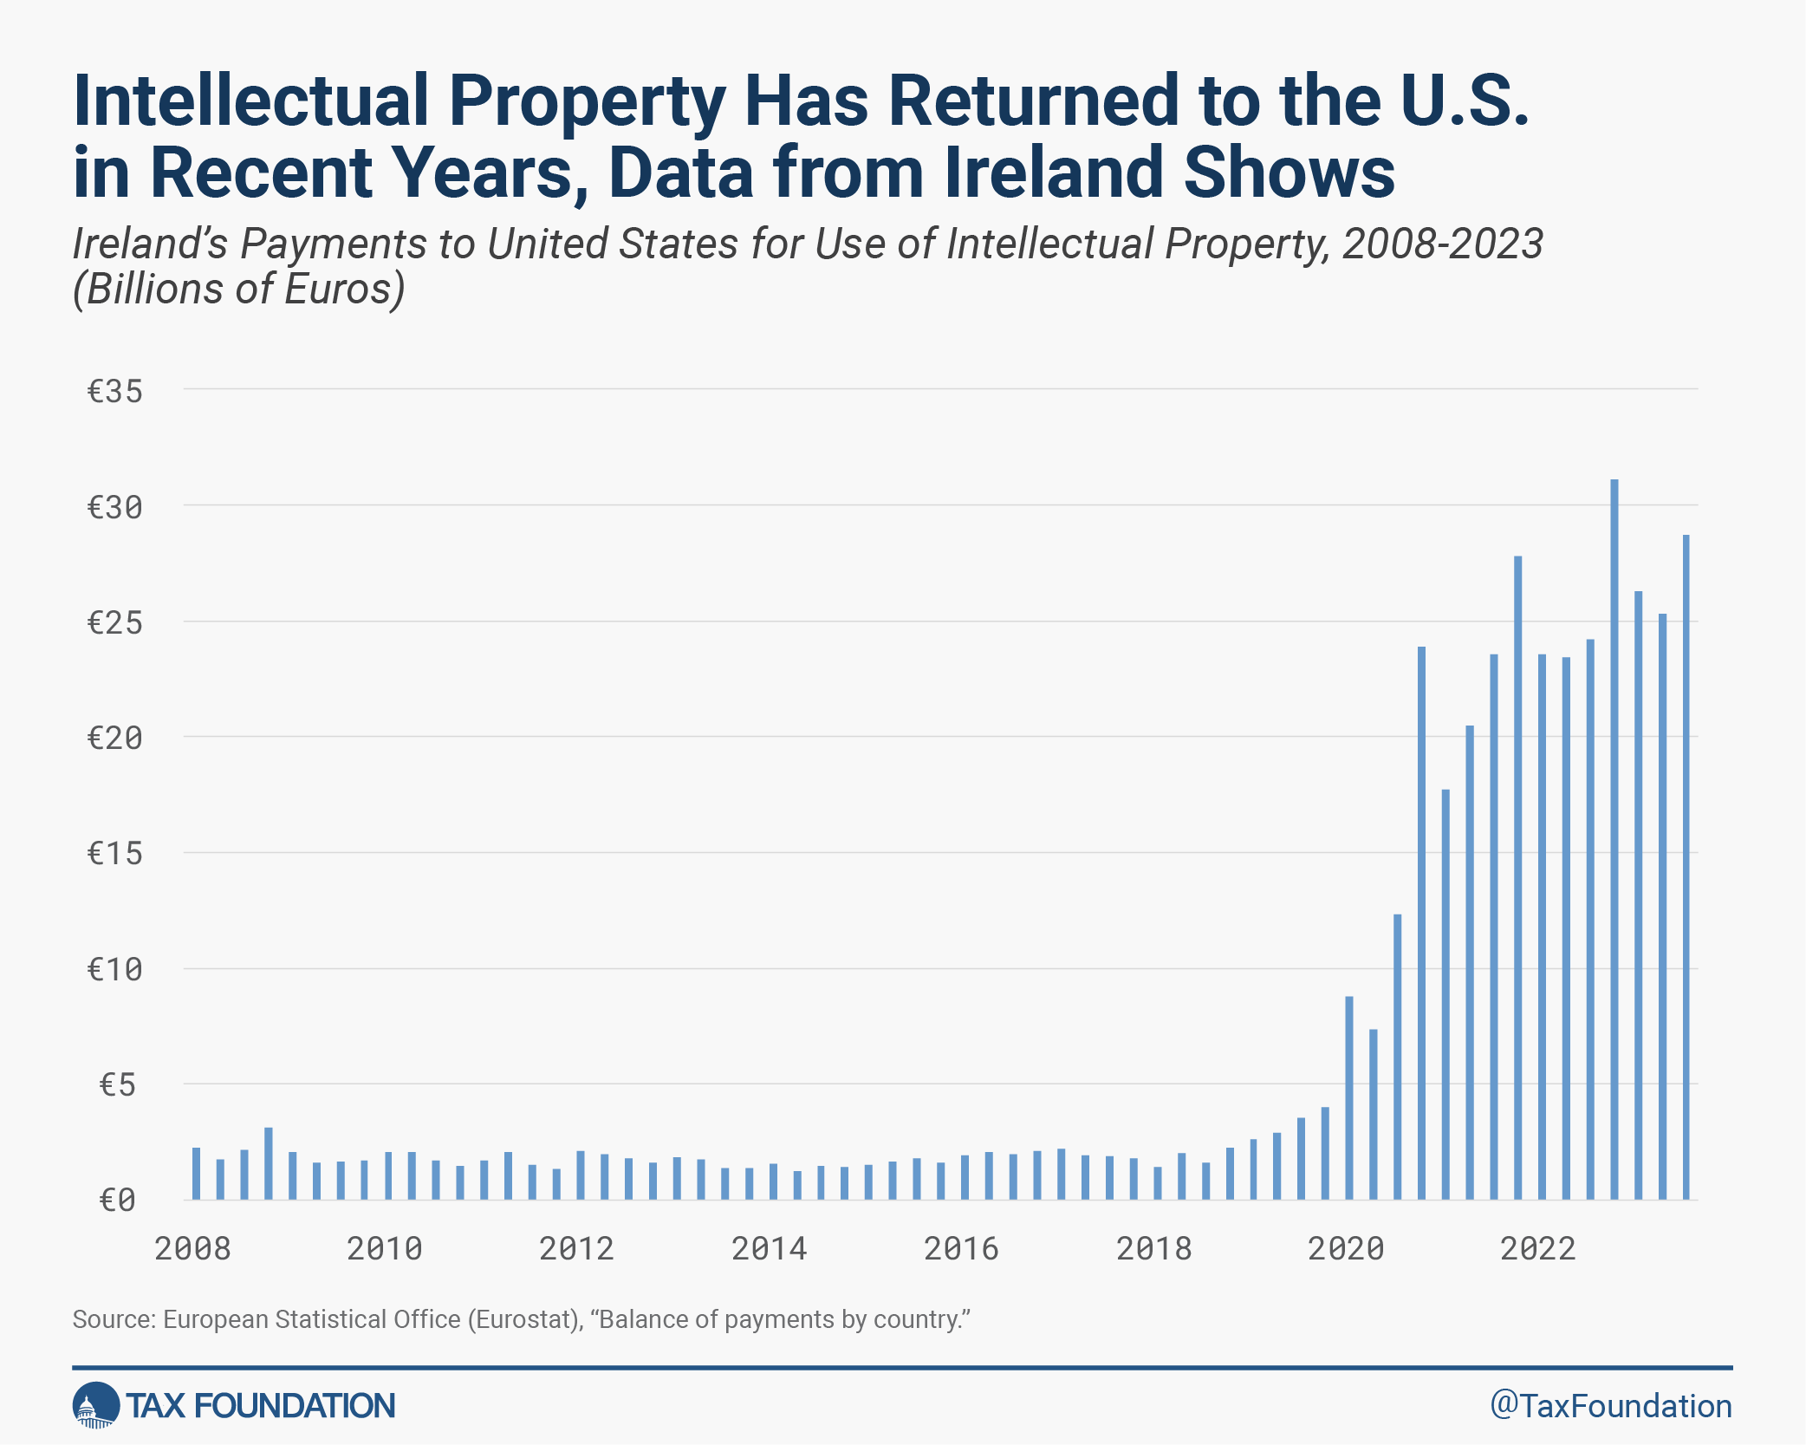

Slide 11
OECD Pillar Two Project
Global minimum tax rate of 15 percent.
Enforced by cascading series of backstops:
Qualified domestic minimum top-up tax (QDMTT), a source-based tax where the operations are happening.
Income inclusion rule (IIR), the residence-based backstop assessed by the parent country.
Undertaxed profits rule (UTPR), an extraterritorial tax.
Complexity, rather than liability, causes the most harm to US businesses.

Slide 12
The Twin Risks of Pillar Two
Distributional Effects
Ambiguous to U.S. Treasury
Foreign tax credits (-)
Profit shifting (+)
Lower shareholder taxes (-)
Negative for U.S. taxpayers
Effects happen regardless of US policy; foreign countries are simply allowed to raise their own rates.
Fiscal Sovereignty
Enforced through extraterritorial UTPR
Foreign countries could tax U.S. earnings of U.S. firms
U.S. has stated intent to retaliate.

Slide 13
This Congress:
2025-2026 likely time for tax reform
Potentially address scheduled increases in TCJA international provisions (GILTI, FDII, BEAT)
Détente with OECD preferable
Potential improvements:
GILTI “expense allocation” deserves a second look; may discourage US R&D.
BEAT could be better targeted by accounting for double taxation, or by accounting for substance or tax rates in the countries to which payments are made.
Tax Foundation research: “Considering Potential International Corporate Tax Reforms in the US.”

