Slide 1
State Tax Policy
Boot Camp
Session Six

Slide 2
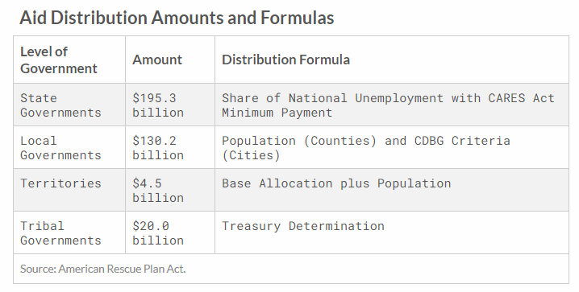
STATE TAX REVENUES
OVERVIEW AND FEDERAL INTERACTIONS
State and local combined tax revenue up 1% in 2020
  State revenue: down 1% (-$11 billion)
  Local revenue: up 4% (+$29 billion)
  S+L combined revenue: up 1% (+$18 billion)
American Rescue Plan Act fiscal relief: $350 billion
Sources of tax revenue stability—
  Federal Reserve intervention to stabilize stock markets (capital gains grew)
  PPP loans (saved jobs and businesses)
  Enhanced and expanded UC benefits (taxable in some states, though with new exclusions)
  Other aid to individuals and businesses, including checks to taxpayers

Slide 3
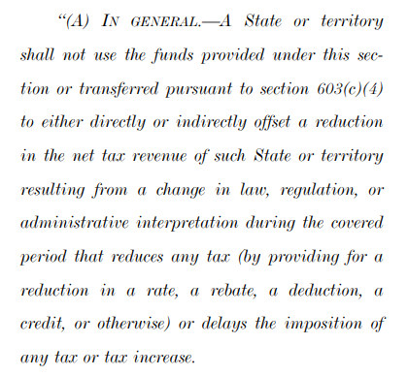
STATE TAX AUTHORITY
ARPA’S TAX CUT LIMITATION
Provision is vague but potentially implicates a wide range of tax decisions—not just rate reductions, but conformity, excluding UC from taxation, adjusting deductions, etc.
Raises constitutional questions if broadly interpreted
  Conditions on states must be unambiguous and not unduly coercive (see Pennhurst, SD v. Dole, NFIB v. Sebelius)
Four questions for Treasury—
  What constitutes a net tax reduction?
  How is a reduction determined to result from a policy change?
  Which expenditures create fiscal capacity for a net tax cut?
  How would offsetting a tax reduction be defined?

Slide 4
POLICIES FOR RECOVERY
OVERVIEW
Conform to federal pandemic-related tax relief provisions, especially those designed to enhance liquidity
Modernize tax rules to better accommodate telework and the new economy
Stop state taxation of Global Intangible Low-Taxed Income (GILTI)
Repeal burdensome taxes businesses must pay regardless of profitability
Fix unemployment insurance (UI) tax systems to prevent tax hikes

Slide 5
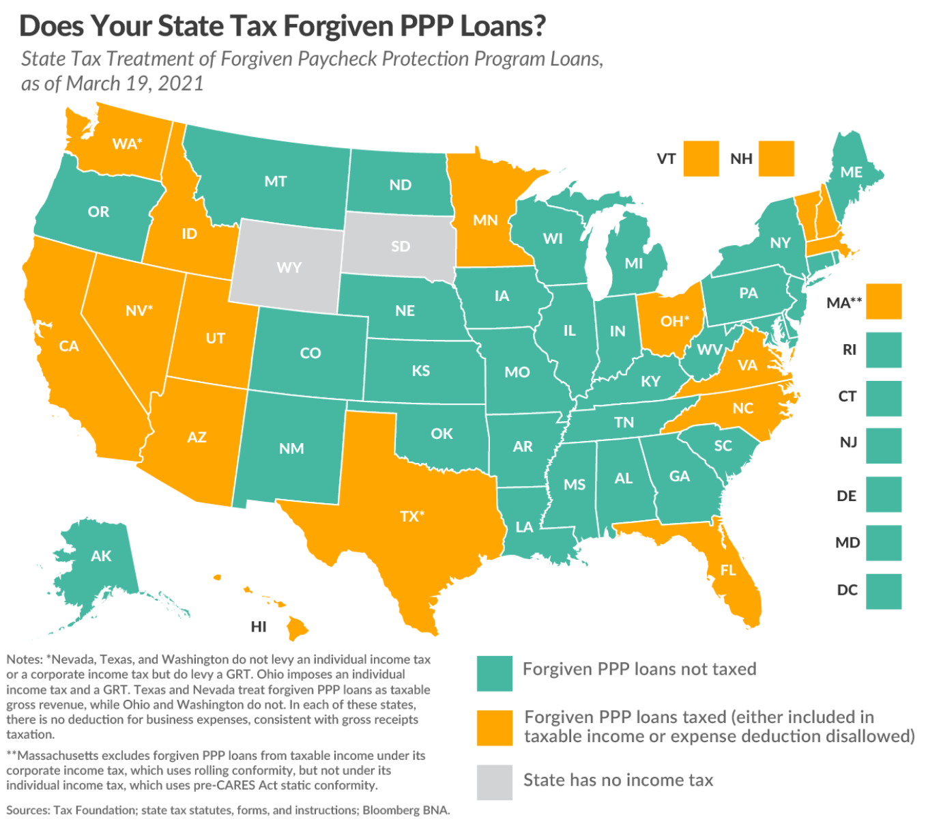
POLICIES FOR RECOVERY
CARES & ARPA CONFORMITY OPTIONS
Exclude PPP loans from taxable income
Expand NOL provisions
Enhance treatment of business interest
Exempt $10,200 of UC from taxation

Slide 6
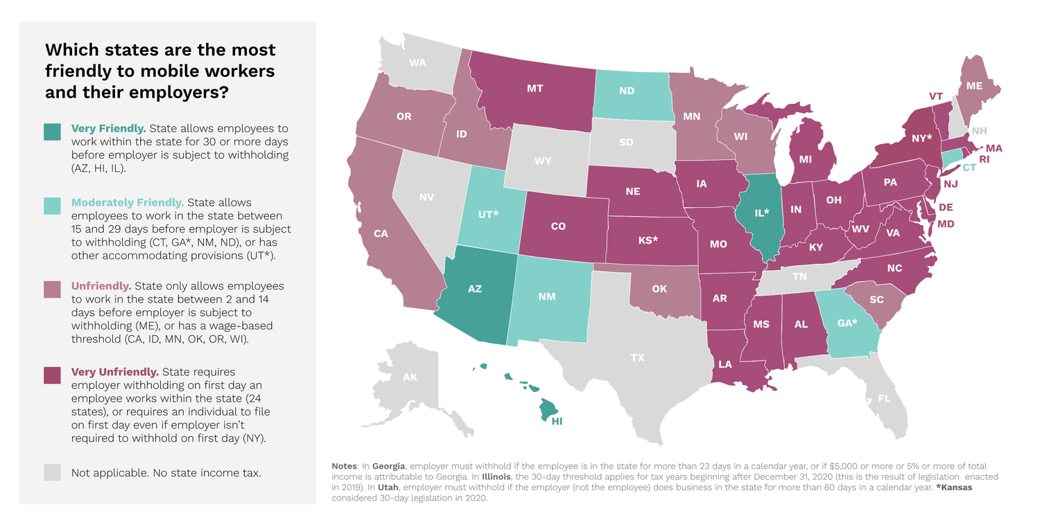
POLICIES FOR RECOVERY
TAX MODERNIZATION FOR THE NEW ECONOMY
Adopt mobile workforce thresholds
Limit nexus for companies whose only physical connection to the state is remote workers
At federal level, modernize P.L. 86-272 or consider something like the Business Activity Tax Simplification Act
Source: Mobile Workforce Coalition

Slide 7
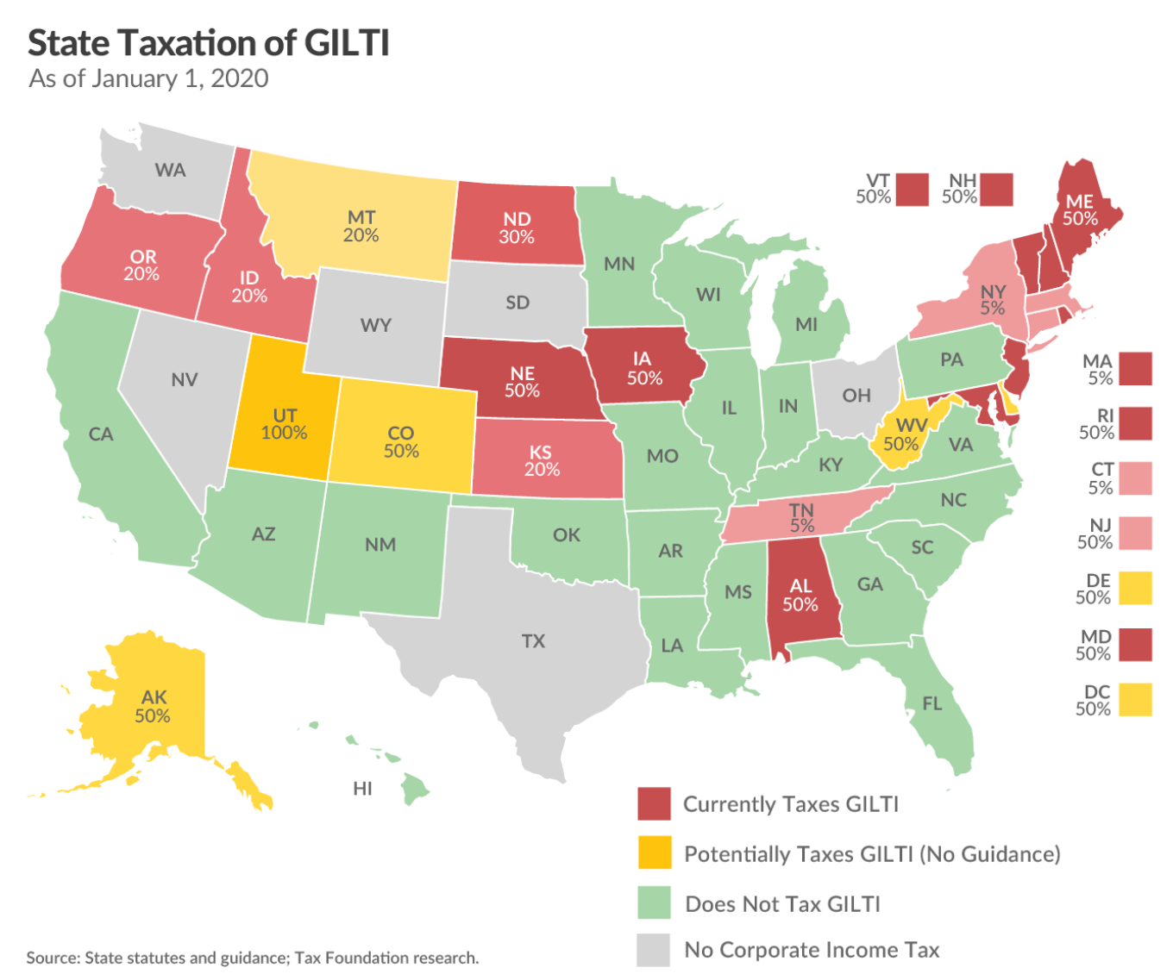
POLICIES FOR RECOVERY
EXCLUDE GILTI FROM TAXATION
GILTI intended as a federal guardrail in shift to quasi-territorial taxation and does not make much sense in a state context
Lack of federal provisions (like credit for foreign taxes paid) leads to excess taxation
Taxing GILTI is complex and makes a state less attractive for investment by multinational firms

Slide 8
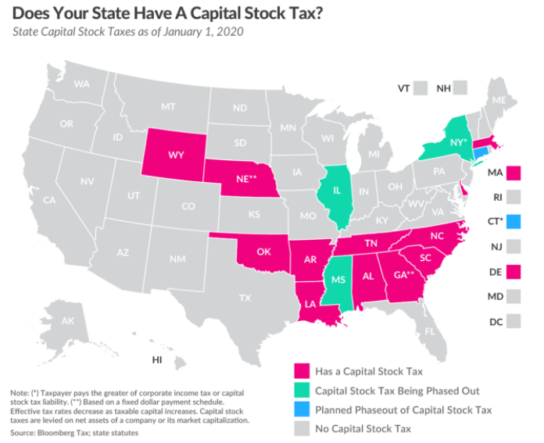
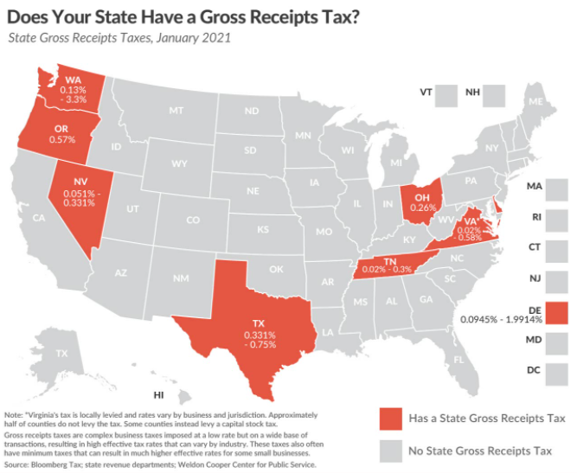
POLICIES FOR RECOVERY
REPLACE TAXES ON UNPROFITABLE BUSINESSES

Slide 9
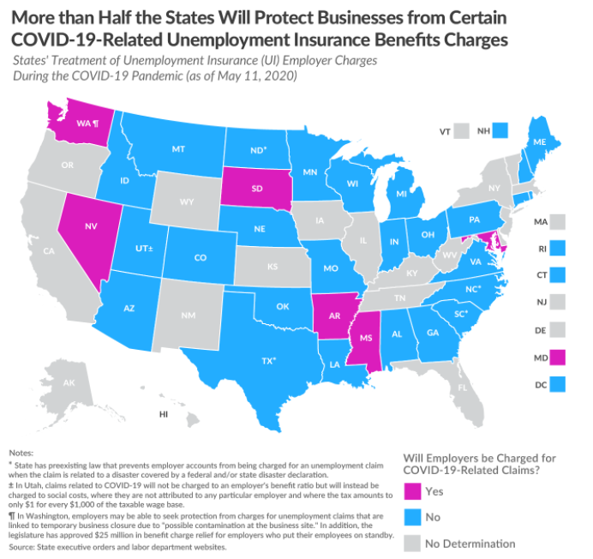
POLICIES FOR RECOVERY
FIX UI TAX SYSTEMS
Many states have acted to prevent automatic adoption of higher tax rate schedules and to prevent employer experience ratings from being impacted by pandemic-related layoffs

Slide 10
POLICIES FOR RECOVERY
REVENUE OPTIONS
States looking to generate additional revenue should consider less economically harmful options
Modernize sales tax bases to additional consumer goods and services while keeping business inputs exempt to prevent tax pyramiding
Reduce reliance on targeted business economic development incentives
  These incentives mostly subsidize economic activities that would have occurred anyway
  This revenue would be better spent making the underlying tax code more structurally competitive for all current and prospective businesses and individuals

Slide 11
THANK YOU!
CONNECT WITH US
All Boot Camp sessions available at www.taxfoundation.org/bootcamp
Join our regular email list at https://taxfoundation.org/tax-newsletter/
Connect with us on Twitter @taxfoundation
Questions? Contact Jared Walczak at jmw@taxfoundation.org or by Twitter DM @jaredwalczak

