Slide 1
State Tax Policy
Boot Camp
Session Five

Slide 2
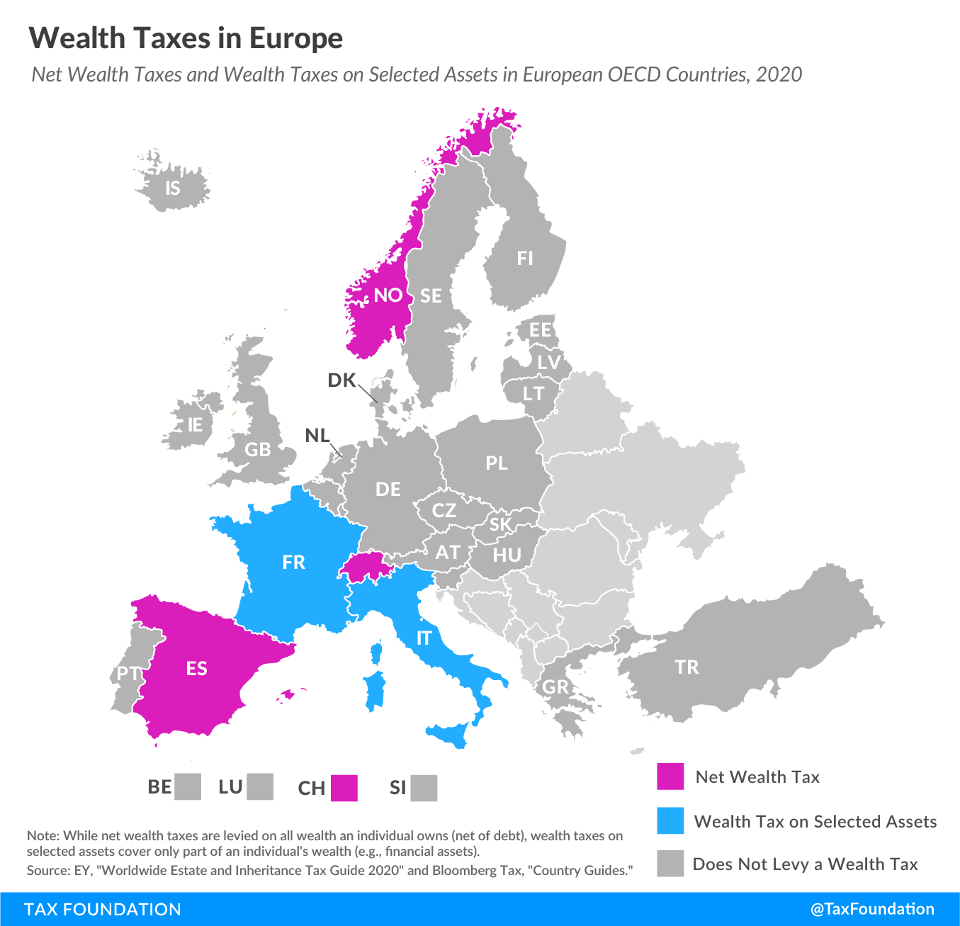
NEW ISSUES IN STATE TAXATION
WEALTH & MARK-TO-MARKET TAXES
Constitutional constraints in many states
  Uniformity clauses, prohibitions on taxing intangible personal property, or limits on taxing income from property
Mark-to-market taxation of capital gains income proposed as an alternative in NY, elsewhere
Both wealth and mark-to-market taxes have an inherent valuation challenge for nontraded assets, and taxes on illiquid assets (including business ownership) can require the asset to be sold to pay the tax

Slide 3
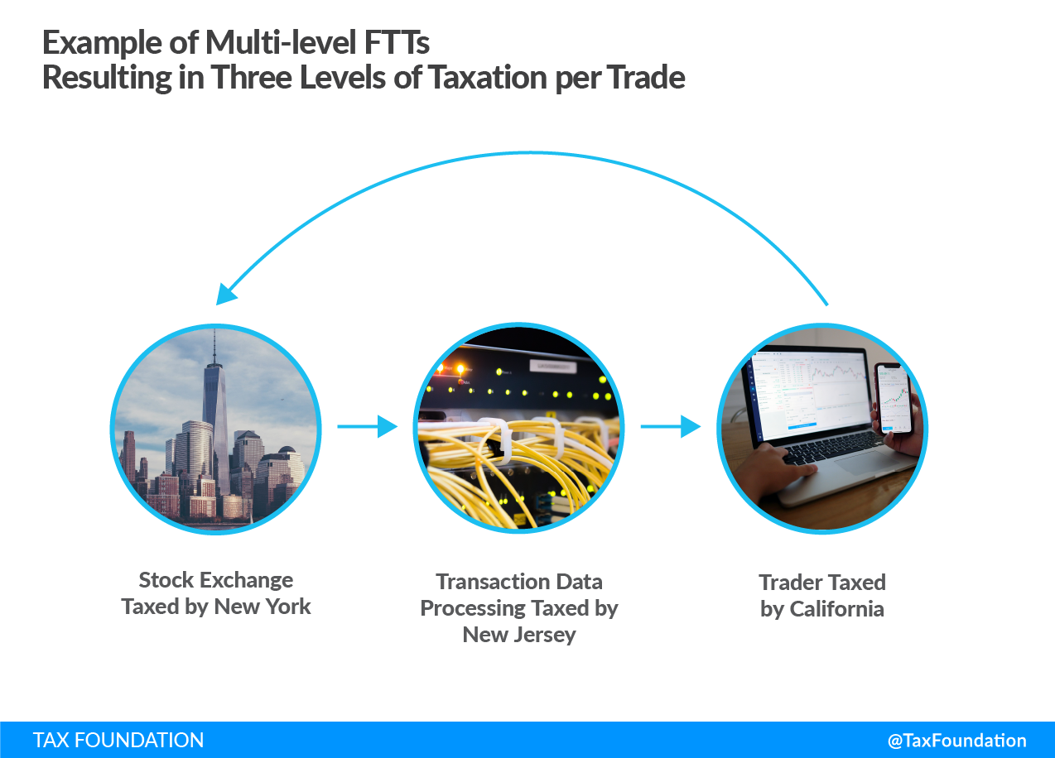
NEW ISSUES IN STATE TAXATION
FINANCIAL TRANSACTION TAXES
Can be imposed on the exchange, the processing of the transaction, or the trader
Can reduce high frequency trading, which may reduce volatility (evidence is mixed) but at the cost of reduced liquidity and price discovery
Raises transaction costs
Potentially strong effect on migration and avoidance, particularly on exchange- or transaction-level taxes, which may be possible for the industry to avoid entirely

Slide 4
NEW ISSUES IN STATE TAXATION
DIGITAL ADVERTISING & DATA TAXES
Imposed on large ad platforms but economic incidence is largely on in-state businesses
Apportioning digital ads to a state is difficult
Likely violation of Internet Tax Freedom Act
Tension with Dormant Commerce Clause
Digital advertising is already taxed in U.S., is a business input, and presents few externalities that could justify a unique tax on it
Data taxes would be an intangible property tax (or structured as a tax on sale of data)
Difficult to value or regulate, and imposes significant burden on interstate commerce

Slide 5
NEW ISSUES IN STATE TAXATION
EXCESS COMPENSATION TAXES & BUSINESS HEAD TAXES
Excess compensation (or CEO excess pay taxes) are a business surtax based on the ratio of the pay of the top-compensated employee and the median full-time employee
Imposed in Portland and now in San Francisco
A state-level tax could see a legal challenge by imposing tax based on foreign characteristics (i.e., compensation of individuals located outside the state)
Business head taxes are per-employee taxes remitted by businesses
May apply to large employers, including low-margin employers like supermarkets
Governments often incentivize job creation, making a tax on job creation highly atypical
Thus far only imposed in Mountain View, CA, after immediate repeal in Seattle, WA and indefinite postponement of consideration in Cupertino, CA

