Slide 1
State Tax Policy
Boot Camp
Session Four

Slide 2
EXCISE TAXATION
WHAT IS IT AND WHEN SHOULD THEY BE LEVIED?
According to the IRS, an excise tax is a consumption tax “imposed on the sale of specific goods or services, or on certain uses.”
The importance of excise tax revenue has declined over time.
Narrow by design and traditionally levied on widely consumed goods like alcohol, motor fuel, and tobacco.
Excise taxes should generally only be levied to internalize negative externalities or to establish a user fee-system.
Low-Income Americans Pay the Highest Effective Federal Excise Tax Rates
Average Excise Tax Rate by Income Group, 2017
Source: Congressional Budget Office

Slide 3
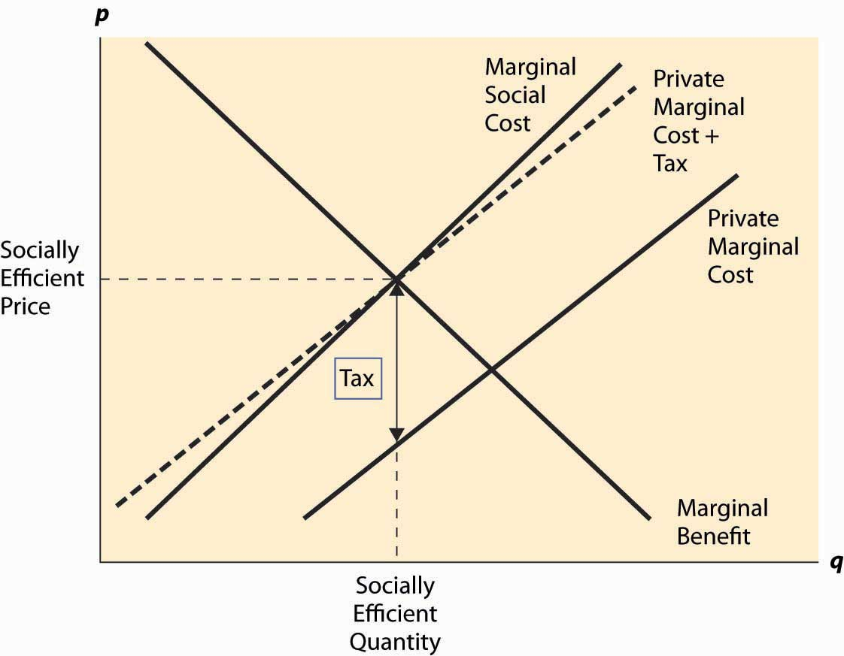
PIGOUVIAN TAXES
WHAT IS IT?
A tax, named after British economist Arthur C. Pigou, on a market transaction that creates a negative externality or an additional cost.
An externality is a side effect, societal cost, or consequence of an economic transaction or activity that is not reflected in the cost of said transaction or activity and not primarily borne by those directly involved in the transaction or activity.
Excise taxes are often in tension with themselves pursuing dual contradictory goals at the same time.

Slide 4

TAX DESIGN
BASE, RATE, AND REVENUE
The tax base should be the best proxy for the negative externality or cost associated with consumption.
Two standard designs:
  Quantity-based (specific).
  Price-based (ad valorem).
Although difficult in practice, tax rates should aim to correspond to the cost associated with consumption.
Taxes should be levied earlier in the value chain to limit the number of taxpayers.
Revenue should be allocated to cover the cost associated with the taxed good or activity.
Five Principles for Excise Tax Design
Economic substitutes should not be included in excise tax bases.
An excise tax should target the negative externality or cost which means the tax base should be the best available proxy for those externalities or cost.
Specific taxes are superior to ad valorem taxes in most cases because quantity is associated with negative externalities or cost while a product’s price often shares no association.
An efficient tax rate is not the same as a revenue maximizing rate.
Appropriately leveled tax rates can be indexed to inflation to retain real value of tax level.

Slide 5
A REGRESSIVE TAX
TAX BURDEN DISTRIBUTION
Tax Burden Paid by Income Group on Selected Federal Excise Taxes and Income Distribution by Income
Consumption taxes may result in higher effective rates for low-income taxpayers.
This effect is made worse if consumption of a good does not increase with ability to pay. Tobacco taxes is the prime example.
The fact that some excise taxes have regressive effects is no argument against levying them.
 | Highway | Air Travel | Alcohol | Tobacco | Income distribution
Lowest quintile | 4.2% | 4.5% | 3.5% | 15.9% | 3.1%
Second quintile | 10.5% | 7.0% | 8.6% | 18.3% | 8.3%
Middle quintile | 17.1% | 14.1% | 17.2% | 18.1% | 14.1%
Fourth quintile | 23.4% | 21.6% | 23.9% | 20.1% | 22.7%
Top quintile | 44.4% | 52.4% | 46.7% | 27.3% | 51.9%
Total | 100% | 100% | 100% | 100% | 100%
Sources: Urban Brookings Tax Policy Center, U.S. Census Bureau

Slide 6
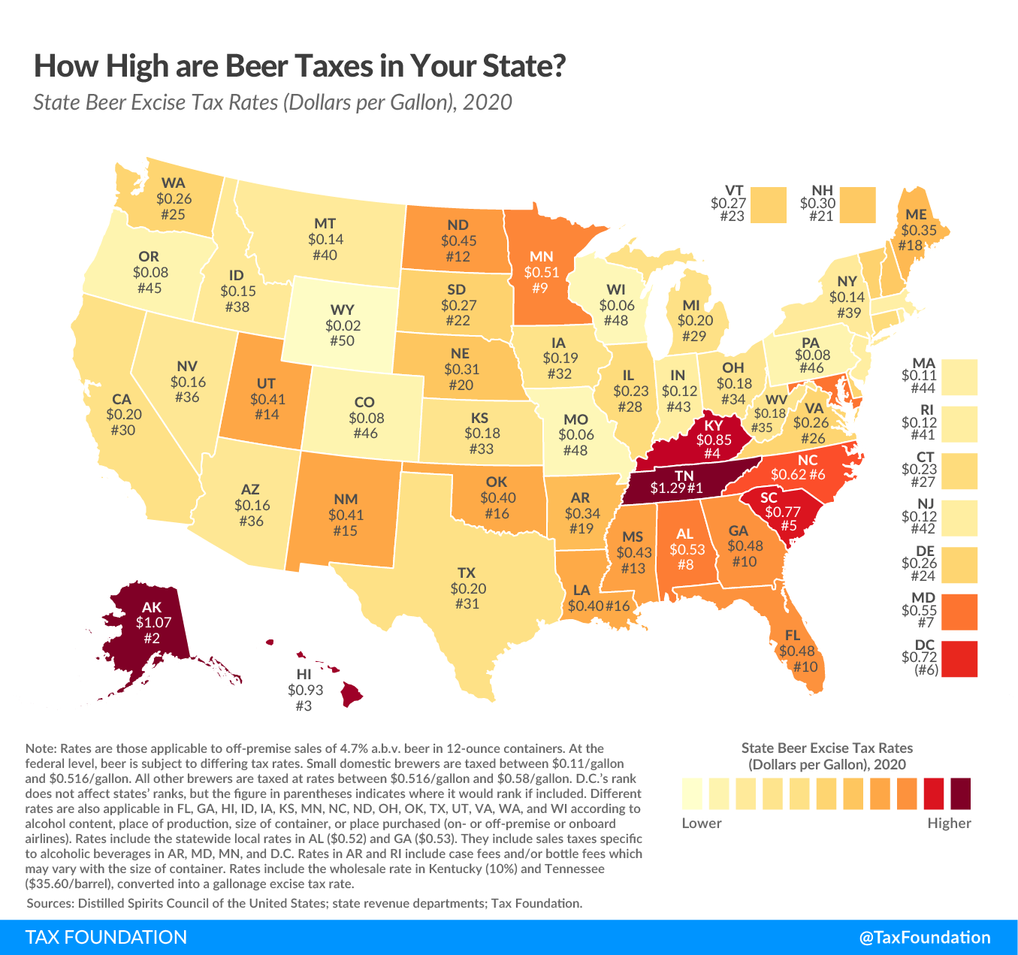
ALCOHOL TAXES
THE FIRST EXCISE TAX
Levied in all 50 states, in the District of Columbia, and by the federal government.
Tax base varies but is commonly alcohol by volume (AbV).
Excise taxes is not an ideal strategy for combatting excessive drinking.
Revenue is often allocated to the general fund rather than to cover costs associated with alcohol consumption.

Slide 7
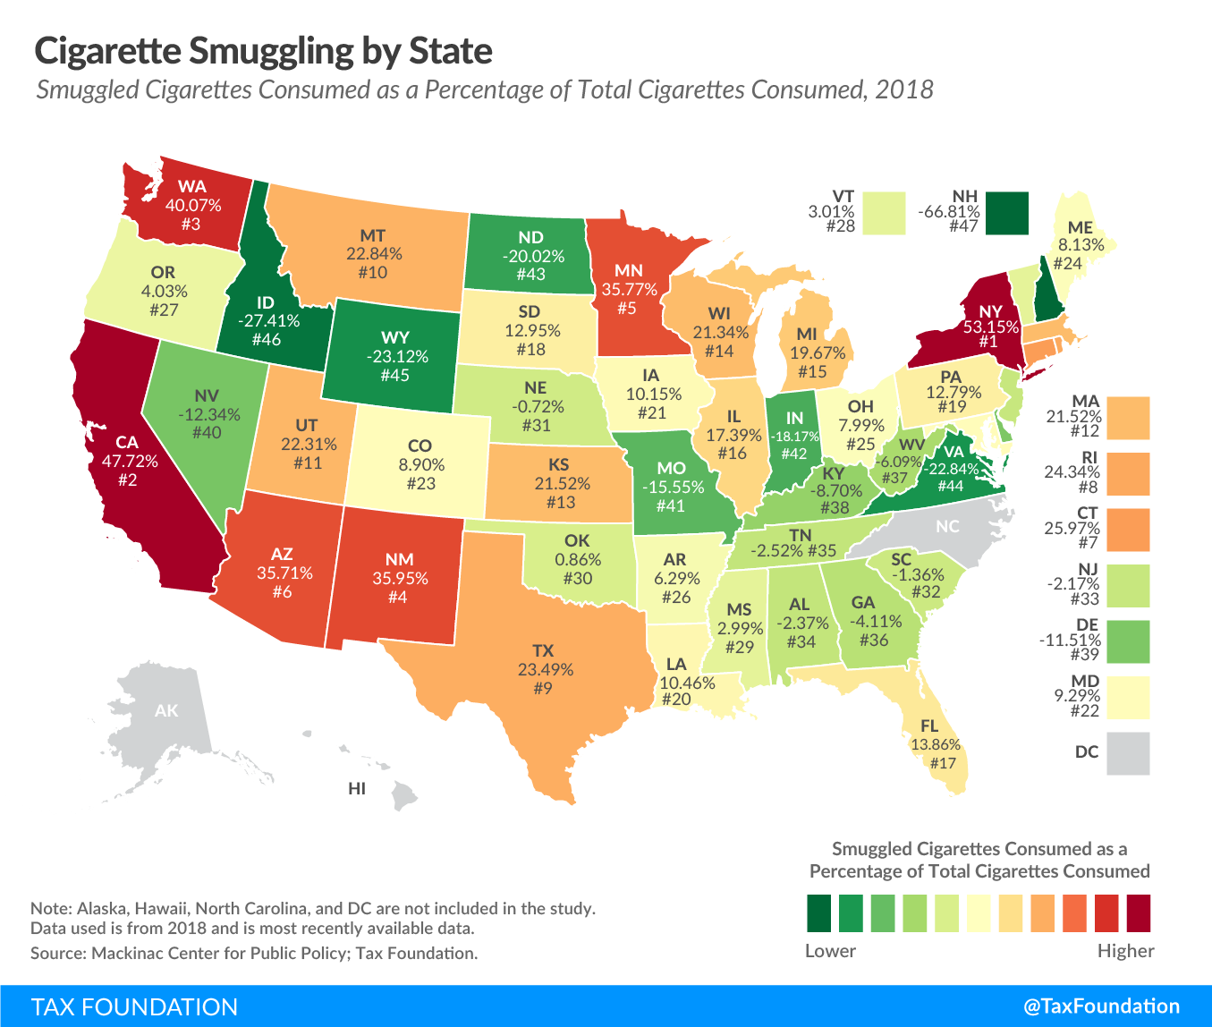
TOBACCO TAXES
A DECLINING REVENUE SOURCE
Tax base differs but is generally based on quantity.
On average, states tax a pack of 20 cigarettes at a rate of $1.88 not including local taxes and general sales taxes.
Taxes make up more than 50 percent of the retail price in Minnesota and New York.
Large differences in price drive smuggling.

Slide 8
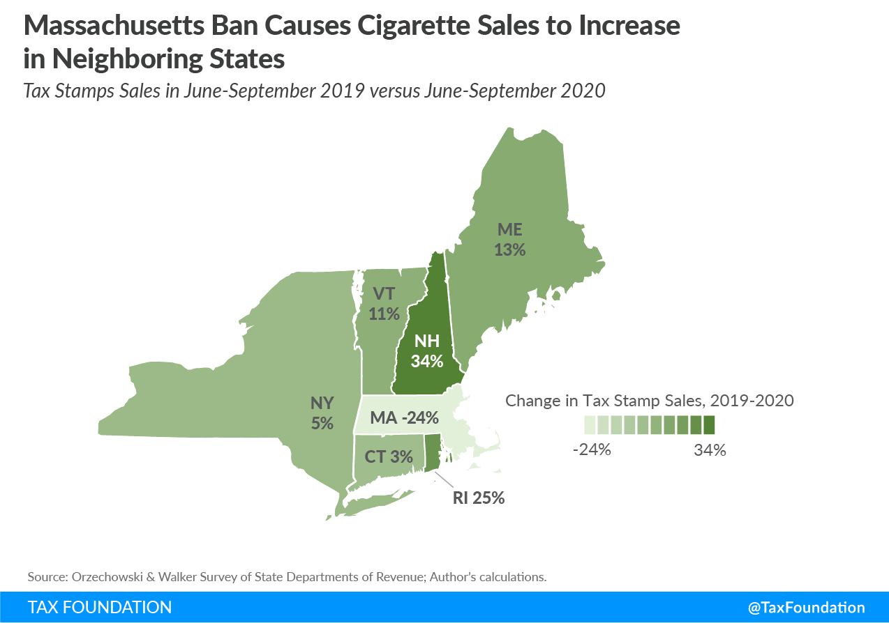
TOBACCO TAXES
FLAVOR BANS
Due to the narrow base of tobacco taxes, policy decisions unrelated to tax policy can have an enormous impact on revenue generation.
Examples:
  Limiting flavor options or
  nicotine content.

Slide 9
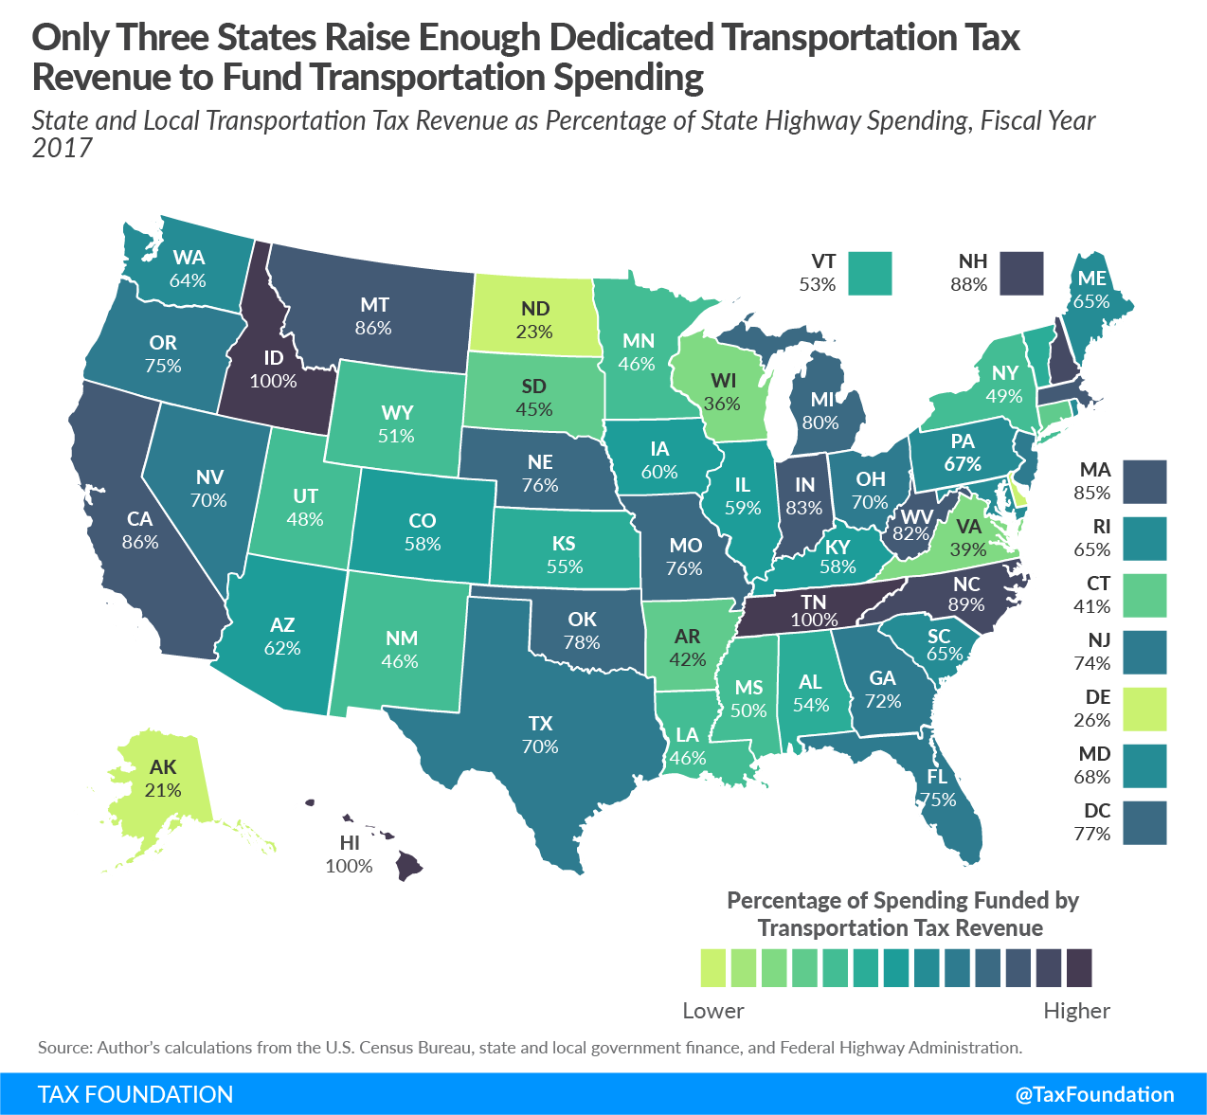
MOTOR FUEL TAXES
IS IT OUTDATED?
Levied on gasoline and diesel as a proxy for road use. Average state excise tax rate in 2020 was 25.6 cents per gallon.
Improvements in vehicles miles per gallon and growth in sales of electric vehicles means that motor fuel is becoming less efficient in capturing costs.
As the vehicle fleet continues to update, it may be time for lawmakers to consider a new proxy for road use.

Slide 10
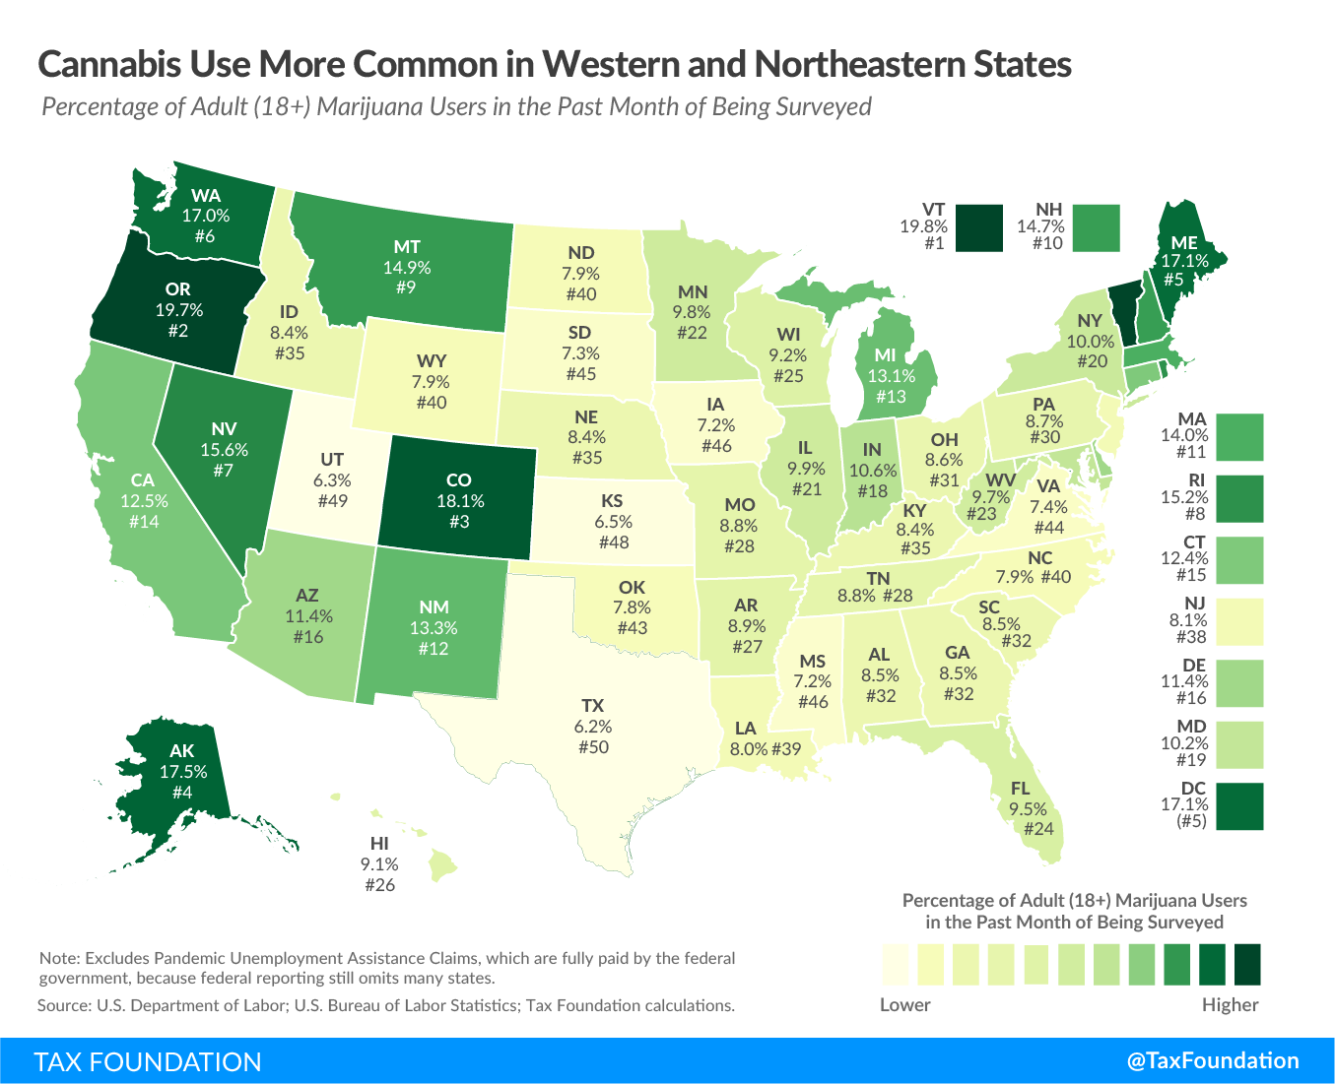
RECREATIONAL MARIJUANA
A FORMIDABLE CHALLENGE
A large number of states are contemplating creating a legal pathway to recreational marijuana sales.
States that have legalized are mostly levying ad valorem taxes.
  One state (Alaska) levies a specific tax.
  10 states levy taxes by price.
  Four states have mixed tax designs.
Any tax system should either be nimble enough or be updated frequently enough to capture new products as they enter the market.

Slide 11
RECREATIONAL MARIJUANA
REVENUE ESTIMATIONS
Missouri | $132
Montana | $39
Nebraska | $39
Nevada (a) | $116 ($99)
New Hampshire | $51
New Jersey | $181
New Mexico | $68
New York | $499
North Carolina | $200
North Dakota | $14
Ohio | $247
Oklahoma | $73
Oregon (a) | $207 ($102)
Pennsylvania | $279
Rhode Island | $41
South Carolina | $106
South Dakota | $15
Tennessee | $146
Texas | $415
Utah | $44
Vermont | $32
Virginia | $154
Washington (a) | $314 ($390)
West Virginia | $44
Wisconsin | $132
Wyoming | $11
Total | $8,143.47
Based on Average Taxes Paid by Marijuana Users in Colorado
State | Annual Excise Tax Revenue Based on Colorado Receipts FY 2019 (Million $)
Alabama | $102
Alaska | $30 ($19)
Arizona | $197
Arkansas | $65
California (a) | $1,209 ($308)
Colorado | $252 ($252)
Connecticut | $112
Delaware | $27
District of Columbia | $31
Florida | $508
Georgia | $213
Hawaii | $31
Idaho | $35
Illinois | $312
Indiana | $171
Iowa | $56
Kansas | $45
Kentucky | $92
Louisiana | $89
Maine | $59
Maryland | $152
Massachusetts (a) | $246 ($22)
Michigan | $326
Minnesota | $134
Mississippi | $51

Slide 12
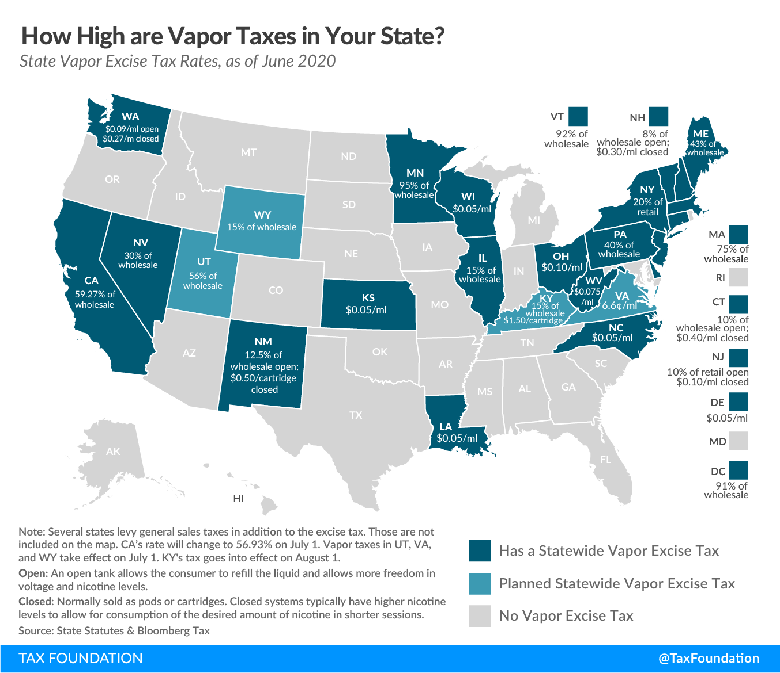
VAPOR PRODUCTS
SHOULD THEY BE TREATED LIKE TOBACCO?
The nicotine market in America has changed dramatically over the last decade.
From a pure public health standpoint, the rationale for taxing nicotine products can seem weak.
The concept of harm reduction is relevant to excise tax design because vapor products are less harmful than combustible tobacco products

Slide 13
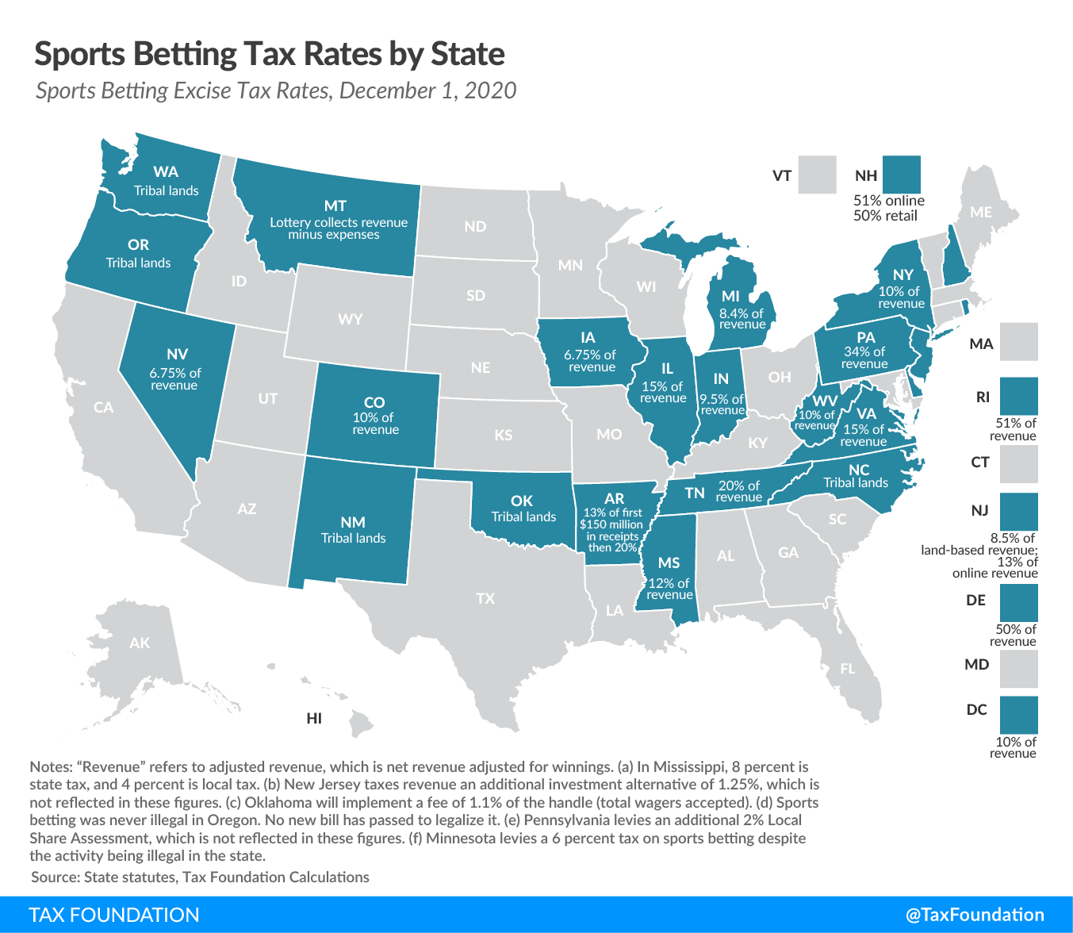
SPORTS BETTING
WHAT ARE THE PITFALLS?
Made possible after SCOTUS decision in Murphy v. National Collegiate Athletic Association.
Example of excise category where ad valorem tax is appropriate.
Like recreational marijuana dispensaries, sports betting operators compete against illicit operators.
Leagues want in on the revenue generation as well with so-called “integrity fees”.

Slide 14

SUGAR-SWEETENED BEVERAGES
IS IT WARRANTED?
Only levied at the local level although several states have been or are considering statewide SSB taxes.
Commonly designed as revenue raisers as they don’t differentiate tax burden between low-sugar and high-sugar beverages.
Base too narrow to internalize negative externalities associated with sugar consumption

Slide 15
LOOKING AHEAD
THE FUTURE OF EXCISE TAXES
More categories relevant for excise taxes continue to emerge and old ones may disappear.
Plastics, spring water, ride-hailing recent examples.
One should remember that negative externalities are associated with most common consumption and that tax policy does not happen in a vacuum.
Excise taxes should generally not be imposed in expectation of raising stable recurring general fund revenue.

