Slide 1
State Tax Policy
Boot Camp
Session Three

Slide 2
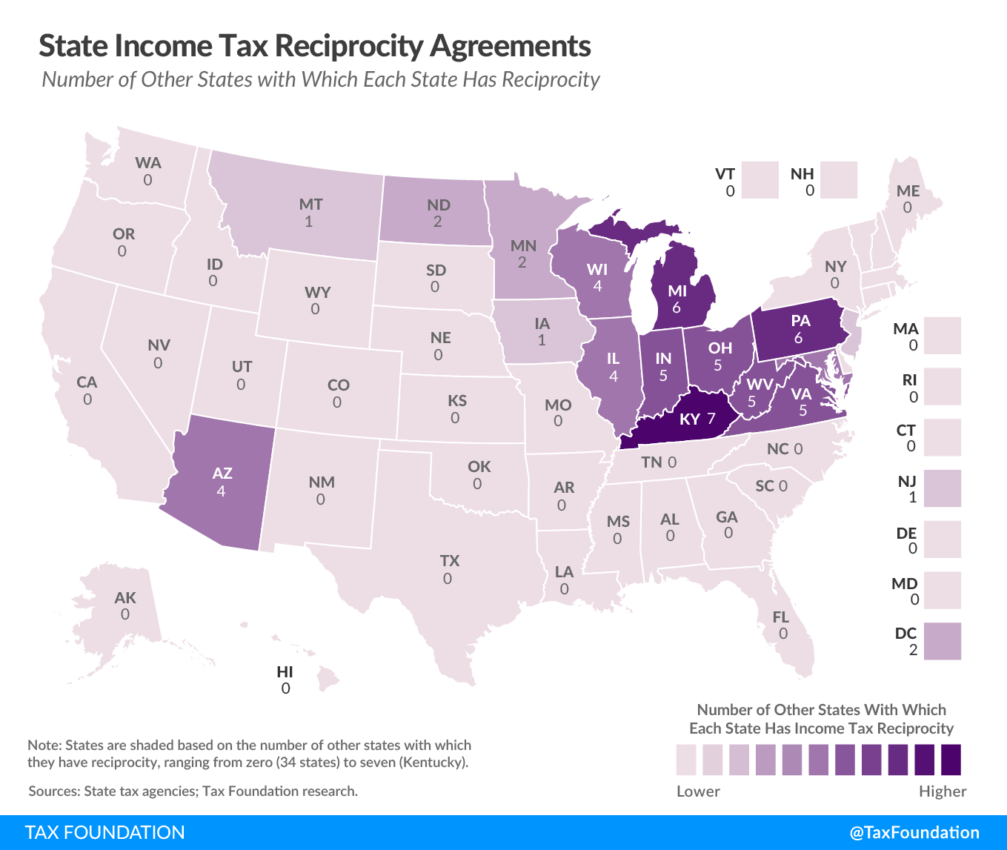
EMPLOYEE TAXATION
WHO CAN TAX YOUR INCOME?
Standard Treatment
  Domiciliary State: all income from all sources, with credits for taxes paid to other states (includes unearned income)
  Other States: income earned in or sourced to the state (excludes most unearned)
Notable Variations
  Reciprocity Agreements
  Treatment of Military / Expat Income
  Convenience Rules (create double taxation)

Slide 3
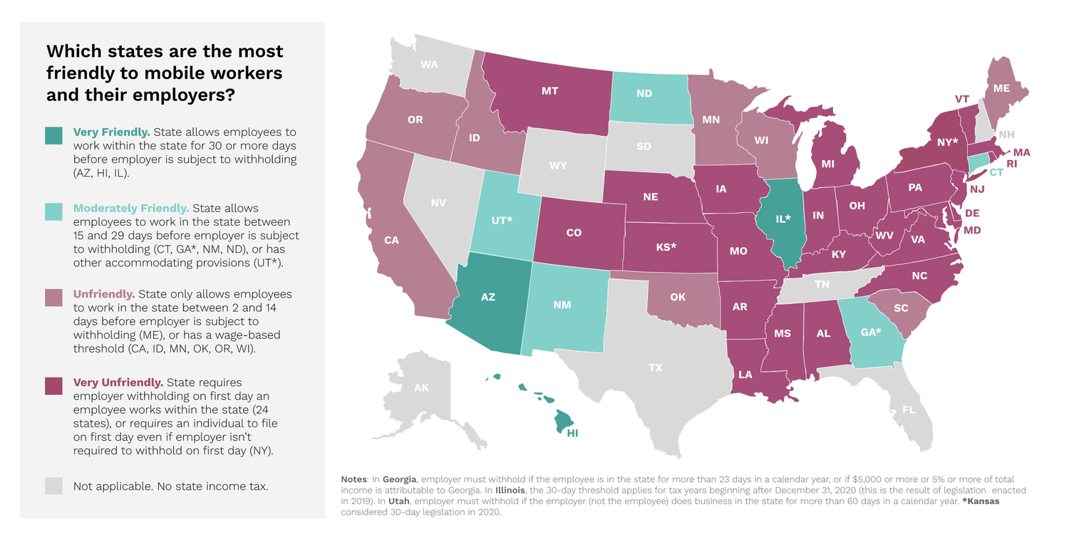
EMPLOYEE TAXATION
FILING AND WITHHOLDING OBLIGATIONS
Most states require an individual to file if they work in-state for even one day and earn any amount of income there
Most states also have withholding obligations for employers when employees travel for work, or work out-of-state
Filing and withholding thresholds, where they exist, do not always align
A filing requirement does not necessarily mean that the taxpayer has any actual tax liability in a given state
Source: Mobile Workforce Coalition

Slide 4
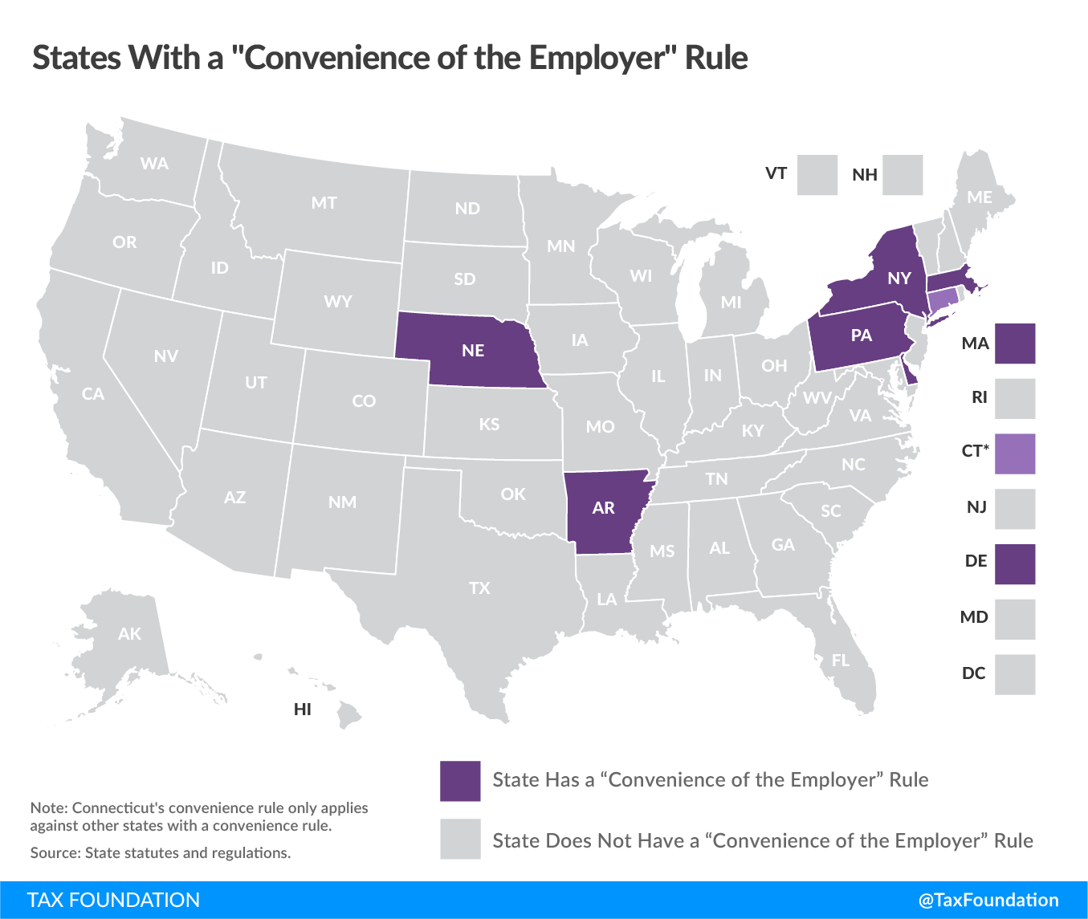
EMPLOYEE TAXATION
CONVENIENCE RULES
Convenience of the Employer Rules impose income tax liability where your office is, regardless of whether you set foot there
Often negates your home state’s credit for taxes paid to other states due to sourcing definitions
Imposed in seven states: Arkansas, Connecticut, Delaware, Massachusetts, Nebraska, New York, and Pennsylvania
Potentially violate Dormant Commerce Clause
Leads to either double taxation or the deprivation of revenue to one’s home state

Slide 5

EMPLOYEE TAXATION
FOUR SCENARIOS
Scenario #1: Commuter Scenario
Live in one state and work in another
Scenario #2: Business Travel Scenario
Live and work in one state but sometimes conduct work elsewhere
Scenario #3: Telework Scenario
Live and remotely work in one state for an employer in another state
Scenario #4: Pandemic Relocation Scenario
Remotely work in multiple states during the pandemic

Slide 6
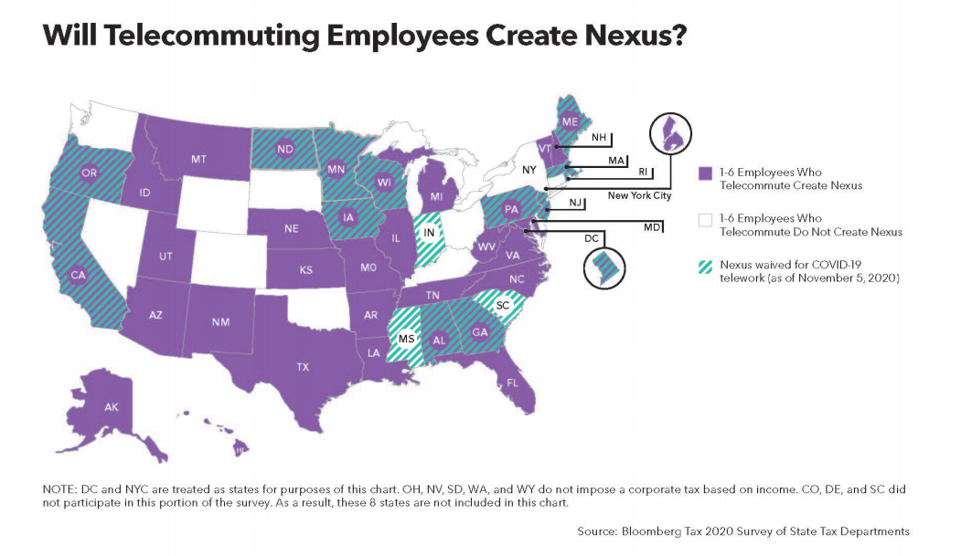
EMPLOYER TAXATION
NEXUS AND APPORTIONMENT
Having even one employee work remotely in another state can establish taxable nexus that could create millions in corporate tax liability
These policies could get some states “blacklisted” as remote work locations
Some states have temporarily waived certain nexus provisions during the pandemic
Remote workers also change apportionment, primarily in states where services are sourced based on Cost of Performance (CoP / IPA)

Slide 7
LOOKING AHEAD
THE FUTURE OF REMOTE WORK
Increased mobility enhances the significance of tax and other forms of state competitiveness
The Great Re-Sorting: Being increasingly untethered from the geography of the job market allows people to locate based on other preferences
The Great Unbundling: taxpayers have greater opportunities to choose locations that offer the mix of amenities and taxes they favor; location less of a “package deal”
An era of greater mobility creates risk for many major metropolitan areas, which must balance potential revenue losses from outmigration against revenue offsets that increases outmigration
State tax policy has always mattered, but the rise of remote work brings tax burdens and economic competitiveness to the forefront

