Slide 1
State Tax Policy Boot Camp
Session One

Slide 2
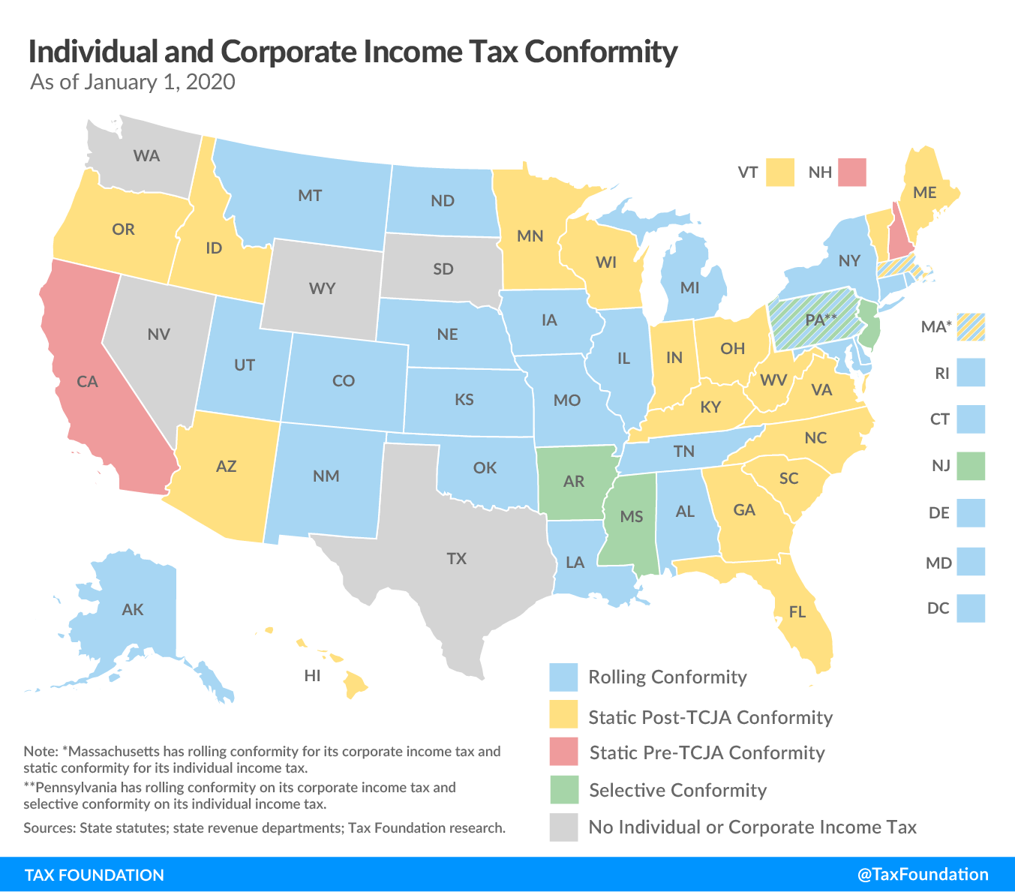
INDIVIDUAL INCOME TAX INCOME STARTING POINT AND CONFORMITY
Rolling Conformity: 22 states + DC
Static Conformity: 17 states
Selective Conformity: 3 states
AGI Starting Point: 29 states
FTI Starting Point: 6 states
State Calculation: 6 states

Slide 3
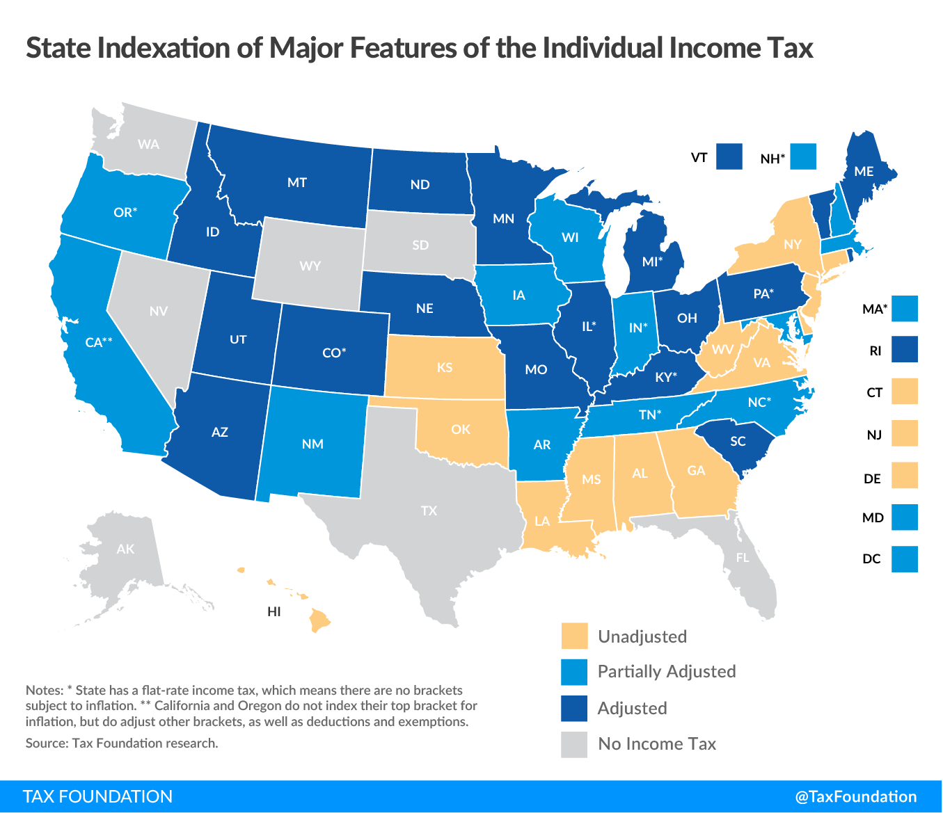
INDIVIDUAL INCOME TAX BASIC ADJUSTMENTS AND INDEXATION
Brackets and Recapture Provisions
Standard Deduction & Itemized Deductions
Personal Exemption or P.E. Credit
Alternative Minimum Tax
Credits for Taxes Paid to Other States
24 states + DC index at least one of the three major inflation-indexable provisions: brackets, standard deduction, and personal exemption

Slide 4
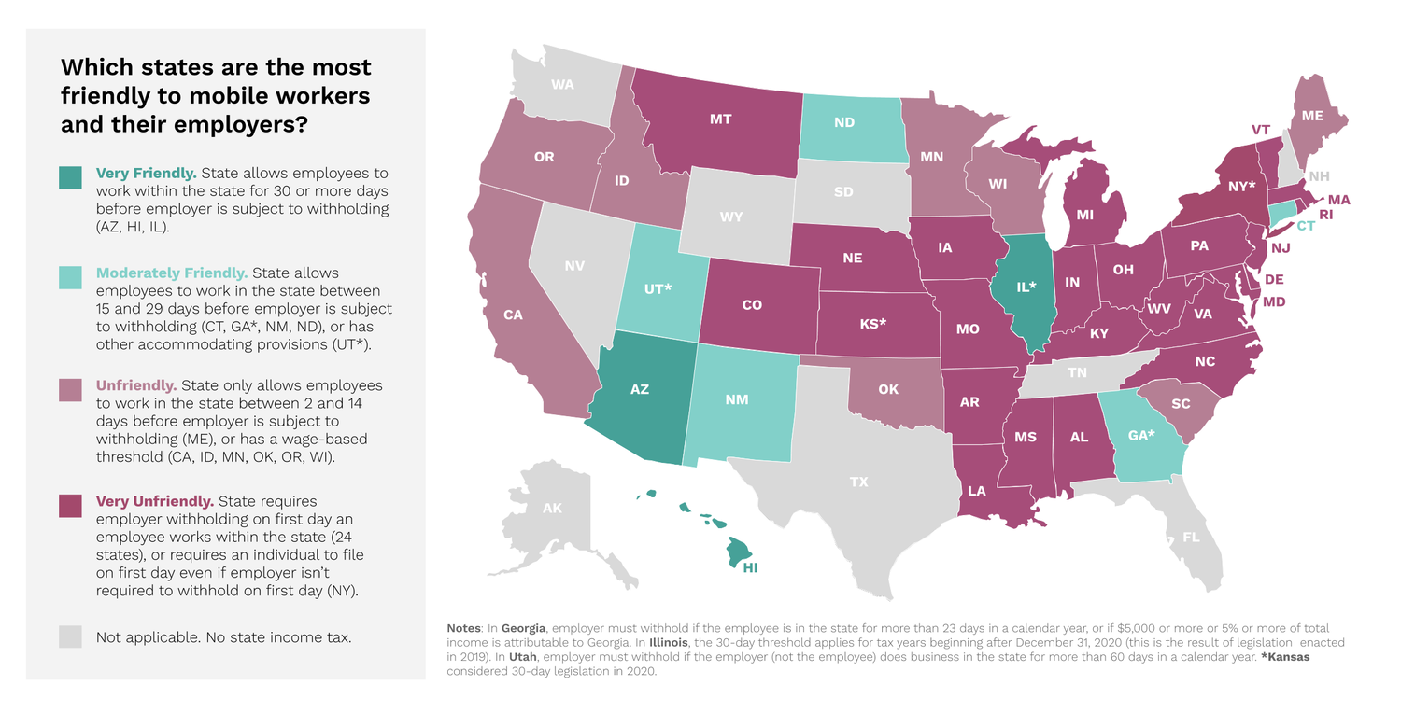
INDIVIDUAL INCOME TAX DOMICILE, MOBILE WORKFORCE, & CONVENIENCE RULES
Domiciliary state can tax all income from all sources
Other states can typically tax income earned in state (home state offsets with credit), but convenience rules, which are imposed where your office is located, upset this balance
Arkansas, Connecticut, Delaware, Massachusetts, Nebraska, New York, Pennsylvania
Most states have very low thresholds for filing and withholding obligations
Source: Mobile Workforce Coalition

Slide 5
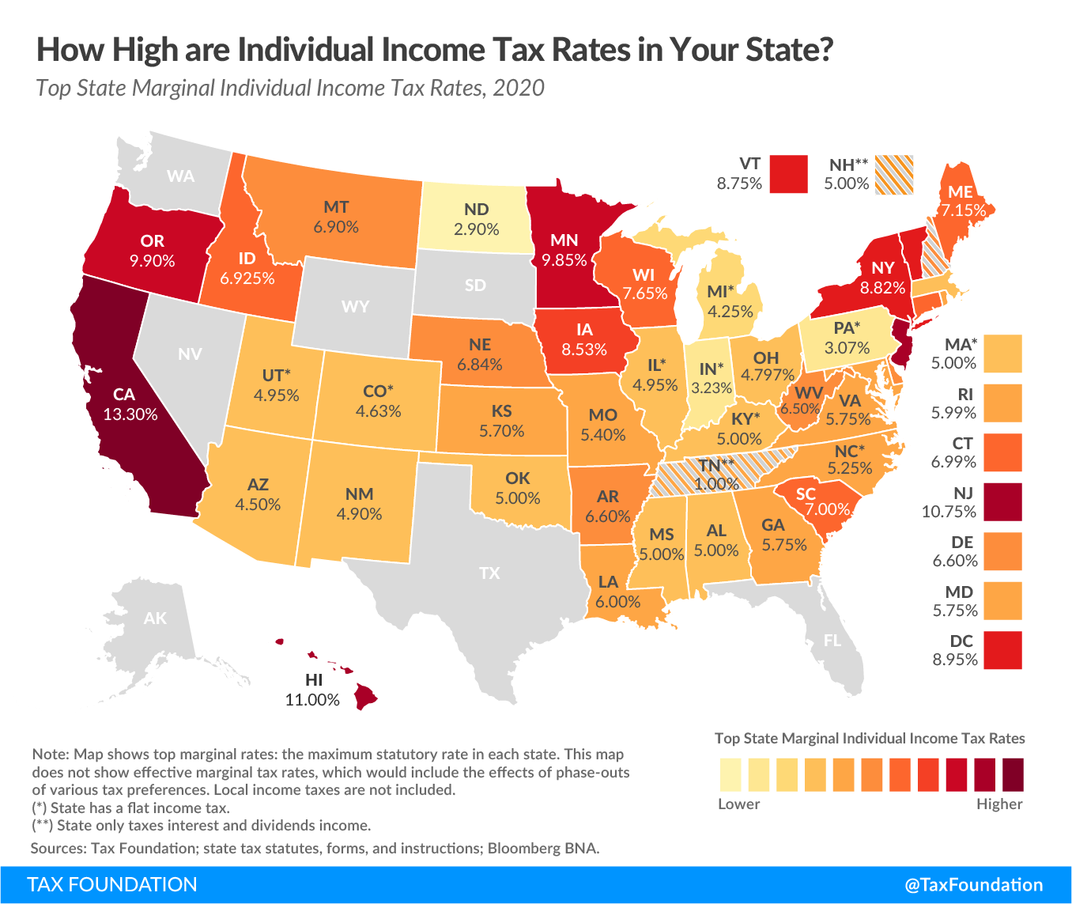
INDIVIDUAL INCOME TAX ECONOMIC IMPLICATIONS
Paid by individuals as well as pass-through businesses (S Corps, partnerships, sole props)
A tax on both present and future consumption, in contrast with a pure consumption tax, like the sales tax or a value-added tax; falls on labor and investment, reduces return to savings
1 percentage point cut in average PIT rate raises real GDP per capita by 1.8%
Pass-through businesses show elasticities of -0.2 to -0.4 on rates
Lower income tax rates are associated with net inbound migration, with top rates particularly important because investment is made at the margin

Slide 6
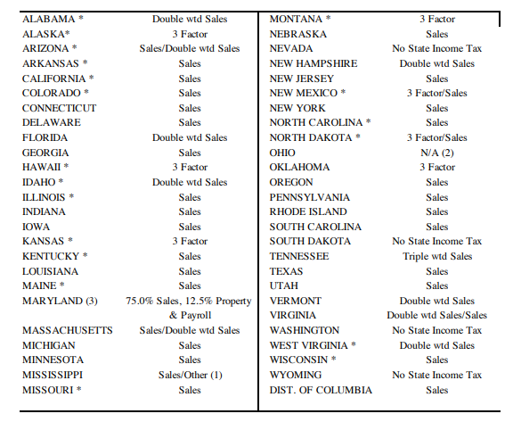
CORPORATE INCOME TAX NEXUS AND APPORTIONMENT
Multistate corporations must have their net income apportioned among states
Three factors traditionally used: payroll, property, sales
Must have “nexus” to a state to have tax liability, but economic contacts usually sufficient, except where company’s only contact is tangible sales into the state (P.L. 186-272)
States increasingly shifting to sales factor apportionment
Service income sourced either based on the where the income-producing activity takes place or where benefits are received
28 states and DC now use combined reporting

Slide 7
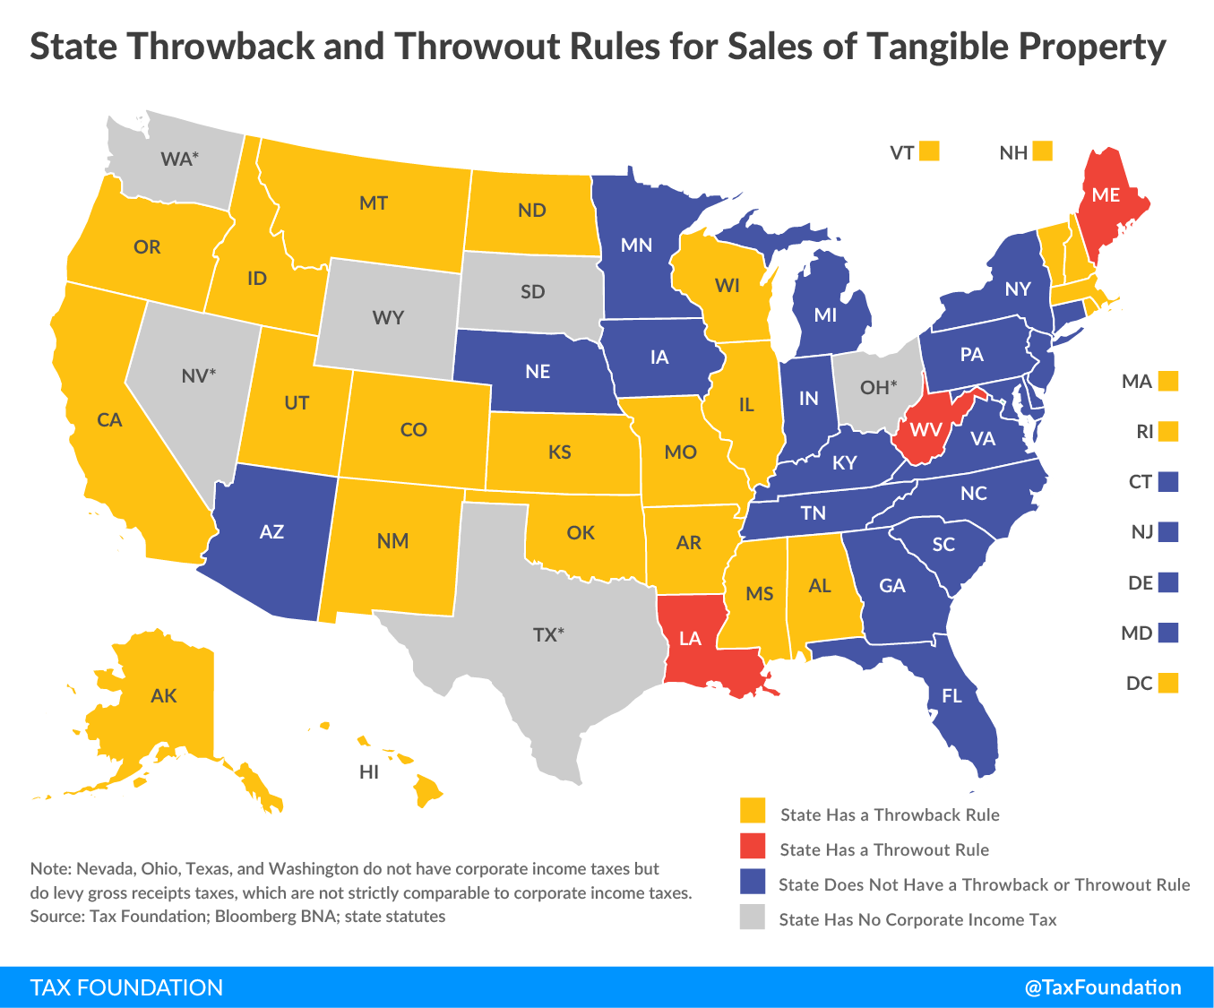
CORPORATE INCOME TAX THROWBACK AND THROWOUT RULES
Sometimes a lack of nexus produces “nowhere income,” which another state may try to capture with a throwback or throwout rule
Under throwback, state in which sales originate may apportion that sale to itself if the receiving state lacks nexus
States must decide whether to apply to separate companies or the unitary group (Joyce and Finnigan rules)—each choice can yield double taxation
Literature suggests throwback rules sufficiently incentivize business restructuring as to produce no net revenue gain

Slide 8
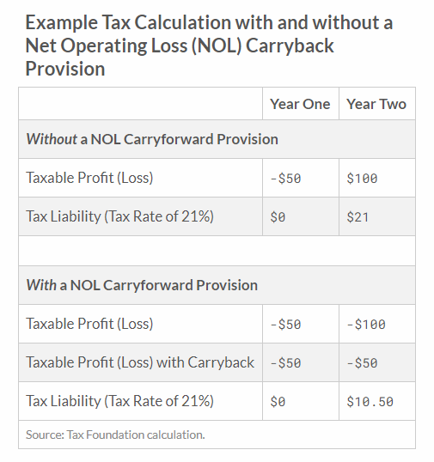
CORPORATE INCOME TAX NET OPERATING LOSSES
Net operating loss carryforward and carryback provisions allow businesses experiencing losses one year to deduct them from another year’s profits, so that the tax is on average profitability
Most states provide 20 year or unlimited carryforwards, but few provide NOL carrybacks
The CARES Act, to which some states conform, temporarily establishes a 5-yr carryback

Slide 9
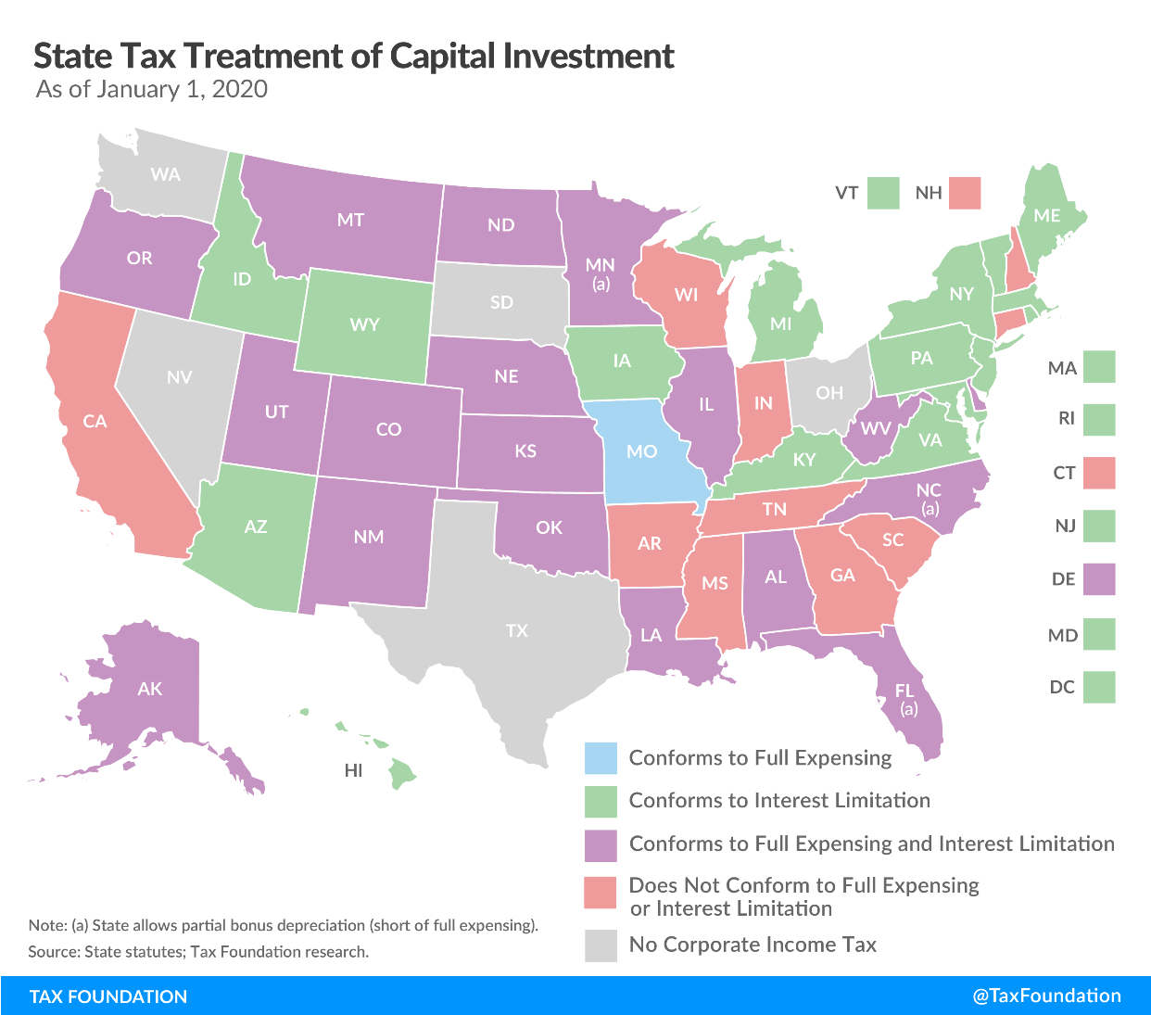
CORPORATE INCOME TAX COST RECOVERY (EXPENSING) AND INTEREST LIMITATION
Corporate income taxes are intended to be on net income, requiring a deduction for business expenses, including purchases of capital assets (cost recovery)
Some business expenses (like payroll) are deducted immediately, but assets were historically deducted across long depreciation schedules
Federal reforms first adopted “bonus depreciation” and then full expensing for short-lived capital assets (machinery and equipment)
TCJA also capped interest deductions at 30% of EBITDA

Slide 10
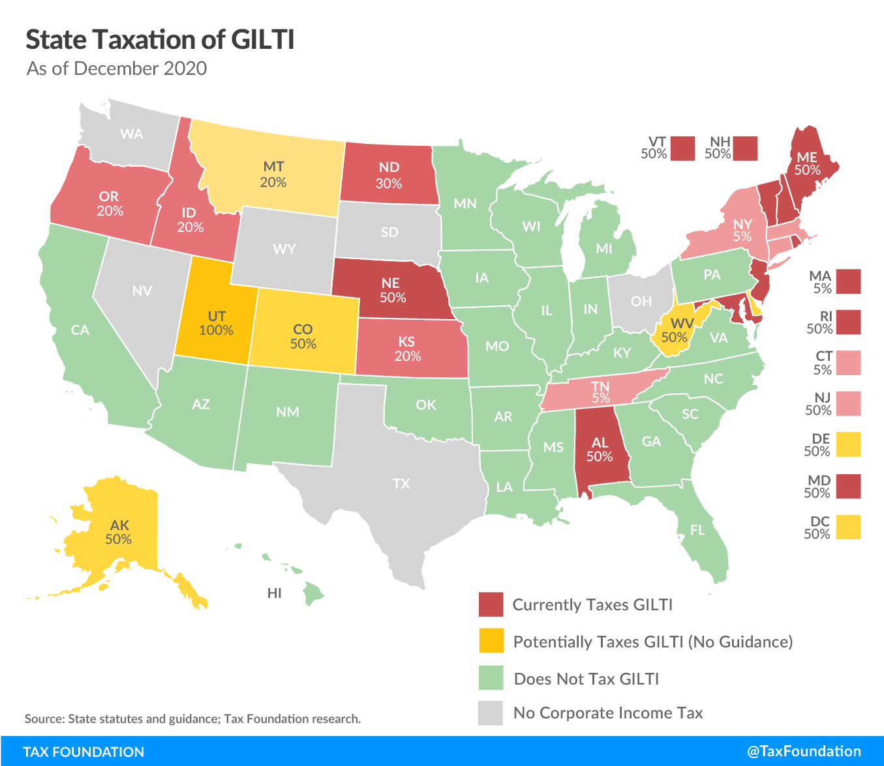
CORPORATE INCOME TAX GLOBAL INTANGIBLE LOW-TAXED INCOME (GILTI)
Intended as a guardrail in federal shift to territorial taxation, but has led to taxation of international income at the state level
At federal level, functions in tandem with other provisions, like the credit for foreign taxes paid, which are absent in state tax codes
Many states exclude or partially abate through their existing deduction for foreign dividend income
Some interactions with state apportionment formulas can be unconstitutional by denying “factor representation”

Slide 11
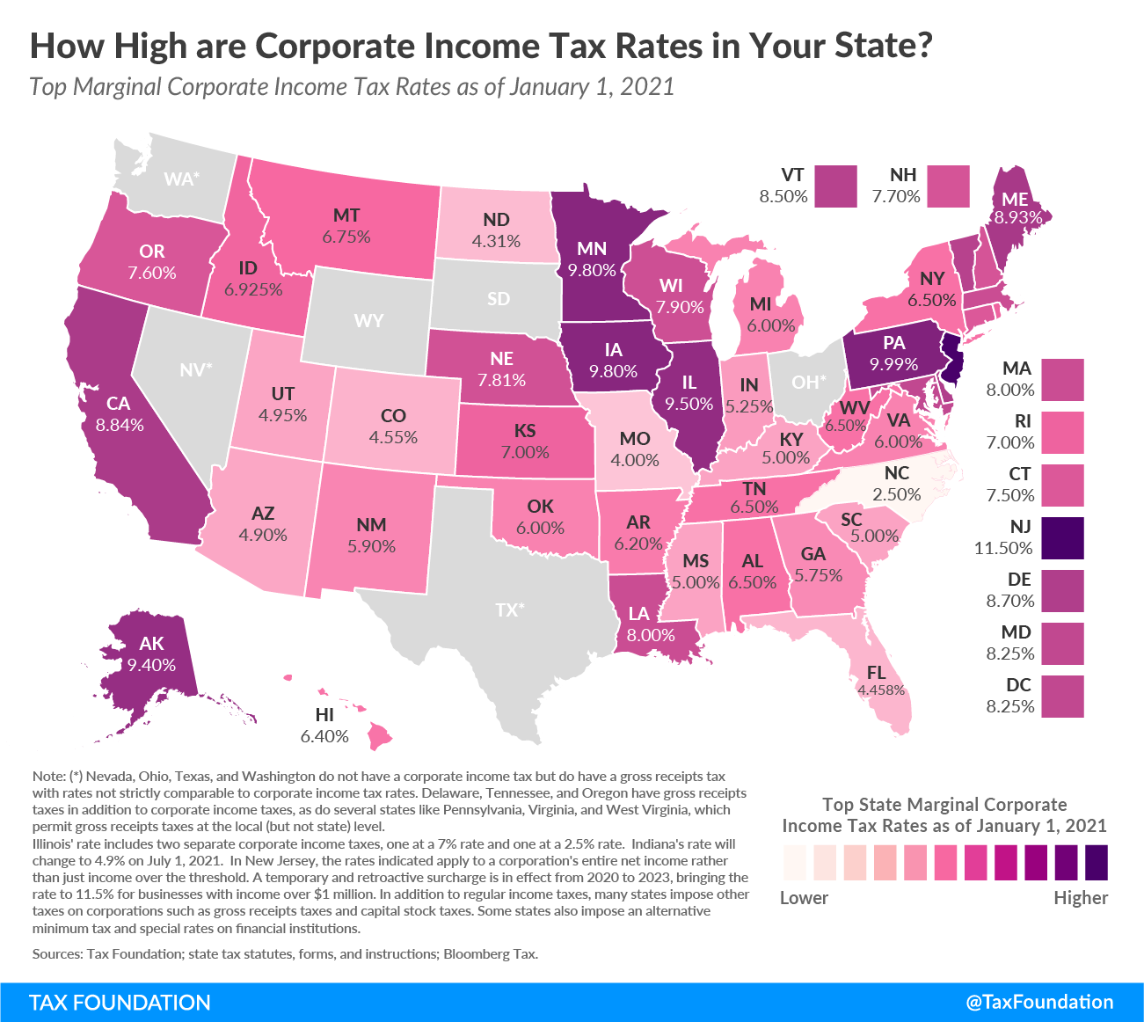
CORPORATE INCOME TAX ECONOMIC CONSIDERATIONS
Highly volatile tax on which most states are reducing reliance (17 states cut since 2008), responsible for about 5% of state tax collections
Progressivity not a meaningful concept in corporate taxation
Studies consistently find corporate income taxes the least pro-growth of the major taxes (among PIT, SUT, prop)
Still preferable to gross receipts taxes, which don’t take profitability into account

Slide 12
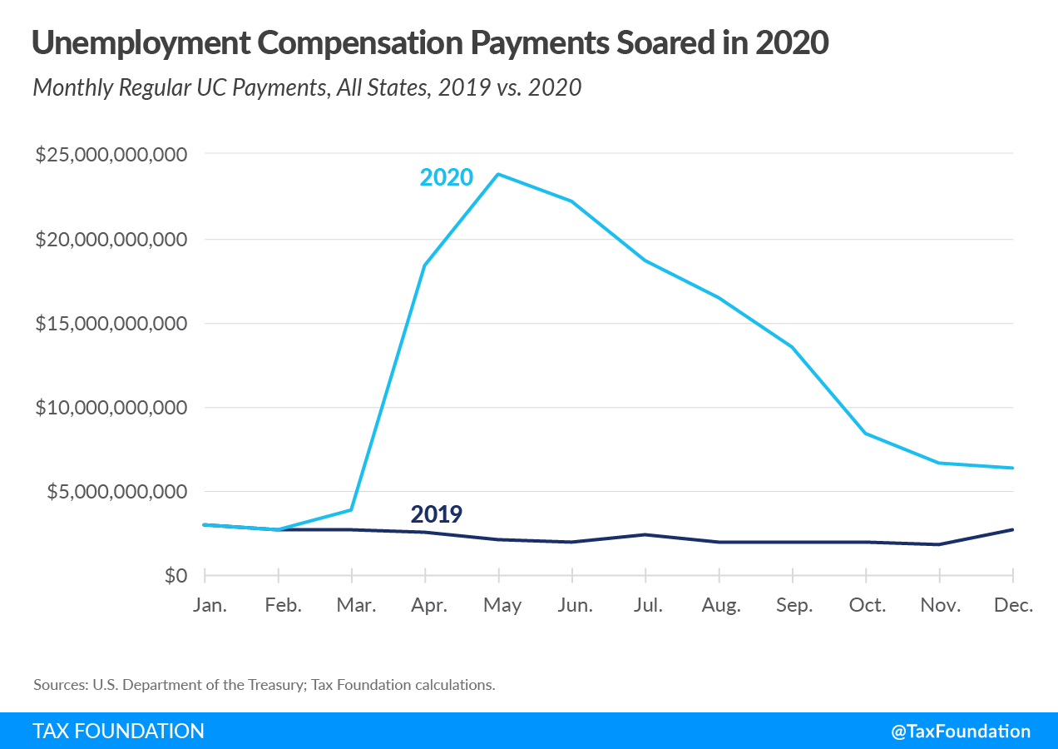
UNEMPLOYMENT INSURANCE TAXES OVERVIEW OF UI TAXATION
UI is a social insurance program jointly operated by federal and state government
State tax rates apply to a taxable wage base ($7,000 to $52,700)
There are minimum and maximum rate schedules, applied based on an employer’s “experience rating”
Many states have solvency taxes and loan repayment surtaxes; rate schedules also rise when funds are depleted
A federal tax of 6% is levied on first $7,000 of earnings but abated up to 90% if state’s UC fund is solvent

Slide 13
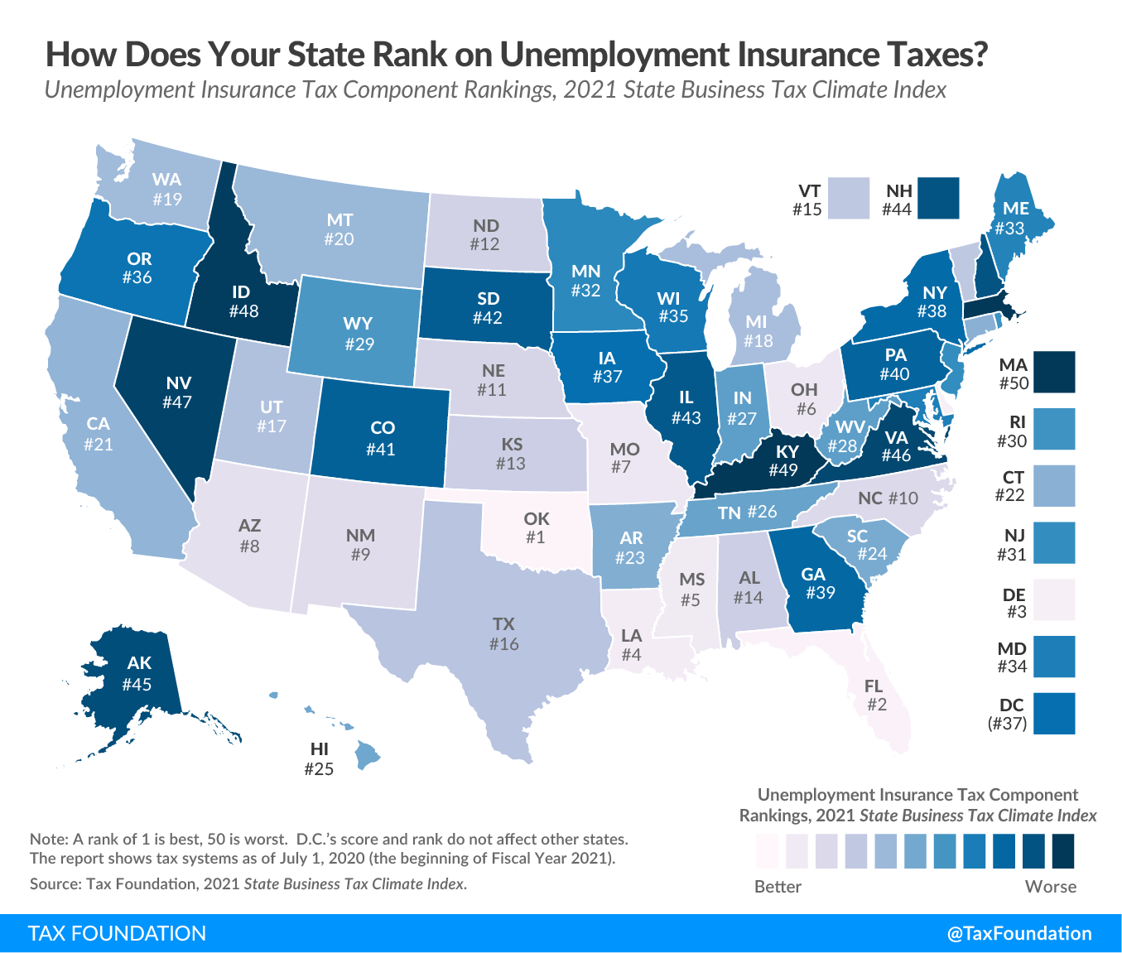
UNEMPLOYMENT INSURANCE TAXES EXPERIENCE RATINGS
A business’s experience rating determines the rate it must pay—whether it will be closer to the minimum or maximum rate of the schedule currently in effect
New businesses pay the least favorable schedule; states vary on how long (1-3 years) until they gain their own rating
Four basic experience formulas: contribution, benefit, payroll, and state experience
Experience ratings will vary depending on which charging method a state uses:
Charging the most recent or principal employer (9 states)
Charging base-period employers in reverse order (6 states)
Charging in proportion to base-period wages (34 states + DC)

Slide 14
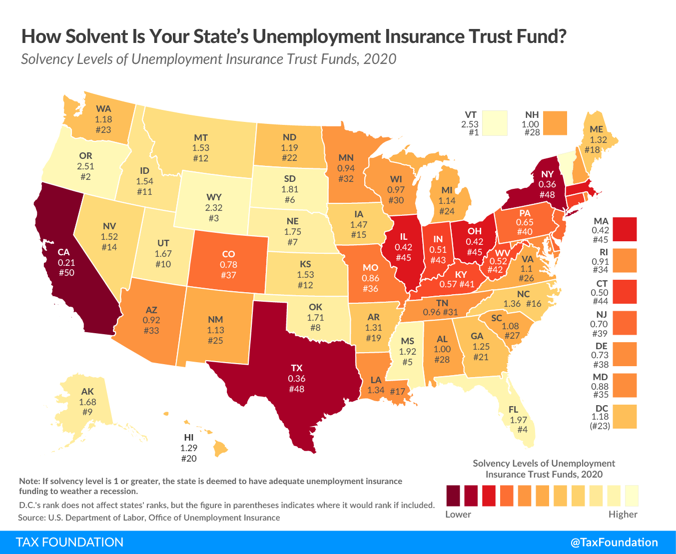
UNEMPLOYMENT INSURANCE TAXES ECONOMIC CONSIDERATIONS
UI taxes are countercyclical, sometimes creating a “shutdown effect”
Many states entered 2020 with nearly insolvent trust funds, frequently paying off prior loans rather than saving for future economic downturns
If states don’t freeze experience ratings or slowly phase in rate increases, businesses could face astronomically high rates on rehiring
States spent $144 billion on regular UC benefits in 2020, up from $31 billion in 2019, and have taken out $48 billion in Title XII Advances (federal loans)

