Slide 1
Considerations for Improving Indiana’s Tax Structure and Competitiveness
Andrey Yushkov, Katherine Loughead
Senior Policy Analysts
ayushkov@taxfoundation.org loughead@taxfoundation.org

Slide 2
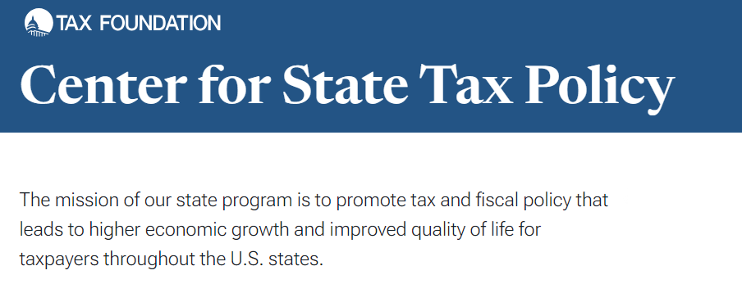
About the Tax Foundation
Principles of Sound Tax Policy
Simplicity
Transparency
Neutrality
Stability

Slide 3
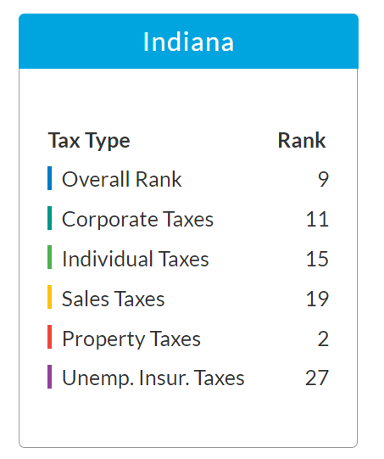
Indiana’s Current Tax Landscape
Indiana’s tax system is already highly competitive
The state ranks 9th overall on the 2023 State Business Tax Climate Index
Indiana has one of the most efficient property tax systems in the nation and performs well on individual and corporate income tax components
Indiana has the lowest PIT and CIT rates among its neighbors (note: Ohio does not have a CIT)

Slide 4
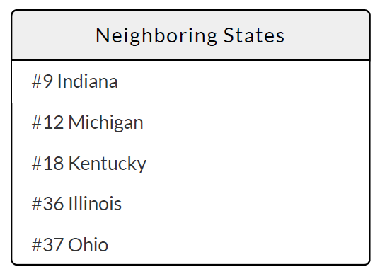
Indiana’s Current Tax Landscape
Indiana is on the right track with its recent individual and corporate income tax changes
Several structural pro-growth reforms are worth considering to improve Indiana’s competitiveness even further

Slide 5
Indiana’s Current Tax Landscape
Revenue structure has been stable in 2014-2023 (and up to 2025, according to revenue projections)
Sales and use taxes account for about 50% of revenues
PIT fluctuates at 34-38%
CIT is at 5-7%
All other sources are <10%

Slide 6
Pros and Cons of Major Revenue Sources
 | Individual Income Taxes | Corporate Income Taxes | Sales and Use Taxes
Pros | Major source of state revenues (~35%) Easily defined and broad tax base Adjustable to various individual and family characteristics | Allow to treat corporate profits separately from individual income | Major & stable source of state revenues (~32%) Broad tax base Are less distortive than income taxes Ideally, are imposed on final consumption and incentivize saving
Cons | Disincentivize saving and investing Hard to compete with the states that don’t impose PIT In most cases, violates simplicity and neutrality | Only a minor source of state revenues (<5%) Volatile during crises Nonneutral and harmful for businesses May lead to tax avoidance and evasion | If designed incorrectly, may lead to tax pyramiding Typically, treat goods and services differently (although both can be final consumption)

Slide 7
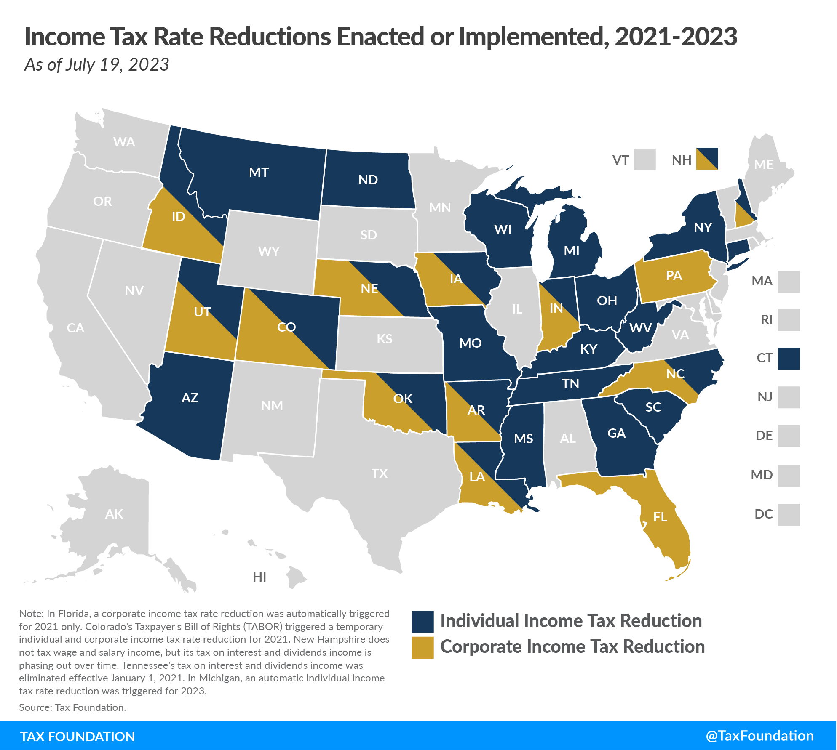
The State Tax Landscape has Grown Highly Competitive
Rate Reductions Since 2021:
Twenty-six states cut individual income tax rates
Thirteen states cut corporate income tax rates
Two states (New Mexico and South Dakota) cut sales and use tax rates

Slide 8
The State Tax Landscape has Grown Highly Competitive
Other states are making structural improvements to their tax codes by
Adopting full expensing
Eliminating throwback and throwout rules
Eliminating capital stock taxes
Improving treatment of business tangible property
Raising nonresident withholding thresholds

Slide 9
Americans are Moving to Lower-Tax States
Net migration to/from Indiana & tax burdens in selected states
Recent trend: Americans relocate from high- to low-tax states
Indiana has a positive “migration balance” with higher tax burden states and a negative “migration balance” with lower tax burden states
Indiana’s tax burden is 9.3%
State | Net Migration | Tax Burden
Illinois | +19,083 | 12.9%
Ohio | +4,578 | 10.0%
Kentucky | +1,932 | 9.6%
California | +1,816 | 13.5%
Florida | -7,644 | 9.1%
Arizona | -4,660 | 9.5%
Texas | -3,982 | 8.6%
Michigan | -1,412 | 8.6%
Sources: 2021 American Community Survey, Tax Foundation

Slide 10
Individual Income Tax
Indiana is one of 11 states with a flat (single-rate) individual income tax
The PIT rate in Indiana (3.15%) is one of the lowest of those states taxing wages, after AZ and ND at 2.5% and PA at 3.07%
However, 9 states, including TN, FL, and TX, do not tax wage and salary income

Slide 11
Individual Income Tax – State vs. Counties
State PIT rate declined from 3.4% to 3.15% in 2014-2023
At the same time, the income tax rate in some counties increased
LIT in Randolph County increased from 1.5% to 3%
LIT in Monroe County increased from 1.06% to 2.04%
Source: Indiana’s Department of Local Government Finance

Slide 12
Individual Income Tax – Reform Options
Reduce the PIT rate according to the statutory schedule
Consider further incremental reductions if the sales tax base is broadened and sales tax collections increase above estimates
Index the personal exemption for inflation and potentially increase it (currently, one of the lowest in the nation)
Reform the local income tax system (e.g., switch to LOST or limit county rate growth)

Slide 13
PIT – Indexing and/or Increasing the Personal Exemption
Seventeen states index SD or PE to inflation; Indiana doesn’t
Between 2018 and 2023:
AZ increased its SD + PE from $14,736 to $27,700
KY increased its SD from $2,480 to $5,540
MI increased its PE from $8,100 to $10,000
GA is scheduled to replace its SD + PE ($13,400 in 2018) with SD ($18,500 in 2024)
In IN, PE remained constant at $2,000
* All values shown are for married couples filing jointly

Slide 14
PIT– Reform the Local Income Tax and Consider a Local Option Sales Tax
Many comparable states allow their localities to impose and collect local option sales taxes, but not local income taxes (IL, AZ, GA, NC, OK)
Limiting county income tax rate growth is a prerequisite of any future income tax reform; otherwise, effective tax burden would not go down
At the local level, switching from taxing income to taxing consumption would make the tax code simpler and more neutral, increasing tax competitiveness

Slide 15
Corporate Income Tax
The flat 4.9% corporate income tax rate in Indiana is already one of the lowest in the nation
The state uses a single sales factor apportionment formula and does not have throwback/throwout rules, which makes it more competitive for in-state businesses

Slide 16
Corporate Income Tax – Reform Options
Consider reducing the corporate income tax rate to remain competitive nationally (tax rates are lower in comparable states: 0% in OH*, 2.5% in NC, 4% in OK, 4.65% in UT)
Consider adopting full expensing to allow businesses to immediately deduct the full cost of certain investments in new technology, equipment, or buildings
* OH does not levy a CIT but does levy a gross receipts tax (GRT)

Slide 17
Sales and Use Taxes
Indiana has one of the highest state sales and use tax rates at 7% (tied for #2 after California)
However, since Indiana localities cannot impose local option sales taxes, the combined rate is #25 in the nation
In Indiana, more than in several comparable states (KY, TN, UT), many consumer services are tax-exempt
As of 2021, Indiana’s sales tax breadth is ~38%

Slide 18
Sales and Use Taxes – Reform Options
Consider broadening the sales and use tax base, e.g., by making consumer services (and not business inputs) taxable
Eliminate 200 transactions from the state’s economic nexus threshold (good practice in recent years; helps reduce administrative complexity for small remote sellers)

Slide 19
Sales Tax Base Broadening – KY Example
From 2017-2023, KY significantly broadened its sales tax base by making 30+ personal services taxable while keeping the rate constant at 6%
As a result, KY’s sales and use tax collections from 2017-2023 increased by 31.5% (in real $)
In Indiana, collections only grew by 13.5% during the same period

Slide 20
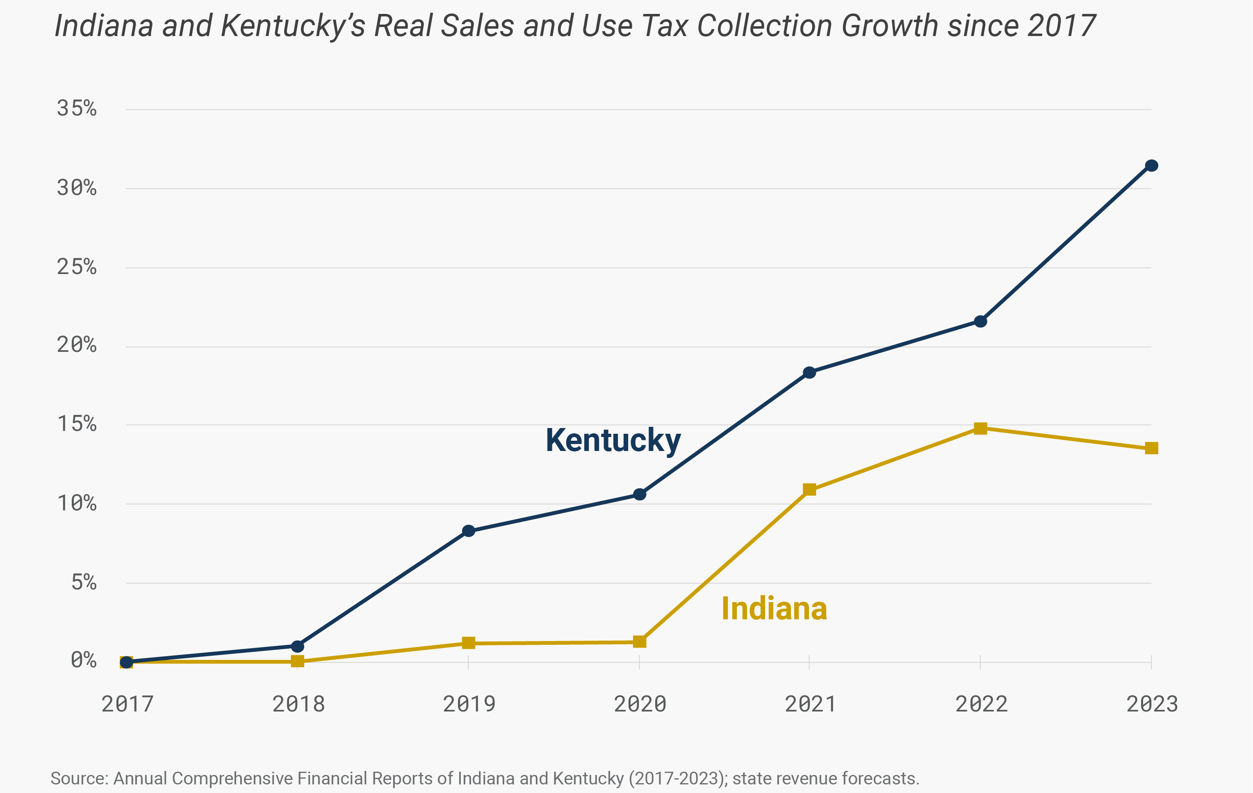
Sales Tax Base Broadening – Kentucky Example

Slide 21
Sales and Use Taxes – Economic Nexus
Several states, including AZ, KS, OK, TN, and WI, have eliminated (or never had) the transaction threshold (typically, of 200 transactions) from their definition of economic nexus
This has reduced administrative complexity for smaller remote sellers and tax administrators alike
Indiana can follow suit and eliminate the transaction threshold

Slide 22
Property Taxes
Indiana’s real property taxes are among the most efficient in the nation
Indiana’s property tax collections per capita and effective property tax rates on owner-occupied housing are below the national average
Indiana does not impose estate, inheritance, or gift taxes

Slide 23
Property Taxes – Reform Options
Preserve the current system of real property taxation, since property taxes are a stable and important source of revenue for local governments
Consider further increasing the $80,000 de minimis exemption or indexing it to inflation
Consider eliminating the 30 percent floor on depreciation of business equipment for TPP tax purposes
Consider gradually eliminating the tax on tangible personal property

Slide 24
Final Thoughts
Indiana’s tax code is structured in a relatively sound manner thanks to years of pro-growth reforms, but additional improvements should be considered to make the state even more economically competitive
Maintaining a well-structured tax code is one of the best policy options available for states that wish to attract steady economic development and sustain a trajectory of consistent job growth, wage growth, and economic growth over the long run

Slide 25
Questions?
Andrey Yushkov, Katherine Loughead
Senior Policy Analysts
ayushkov@taxfoundation.org loughead@taxfoundation.org

